Slide 1

Что такое
Cisco Meraki?
Daniela Di Gioia
Cisco Meraki
dadigioi@cisco.com

Slide 2


Основные принципы
Простота
Безопасность
Анализ

Slide 3
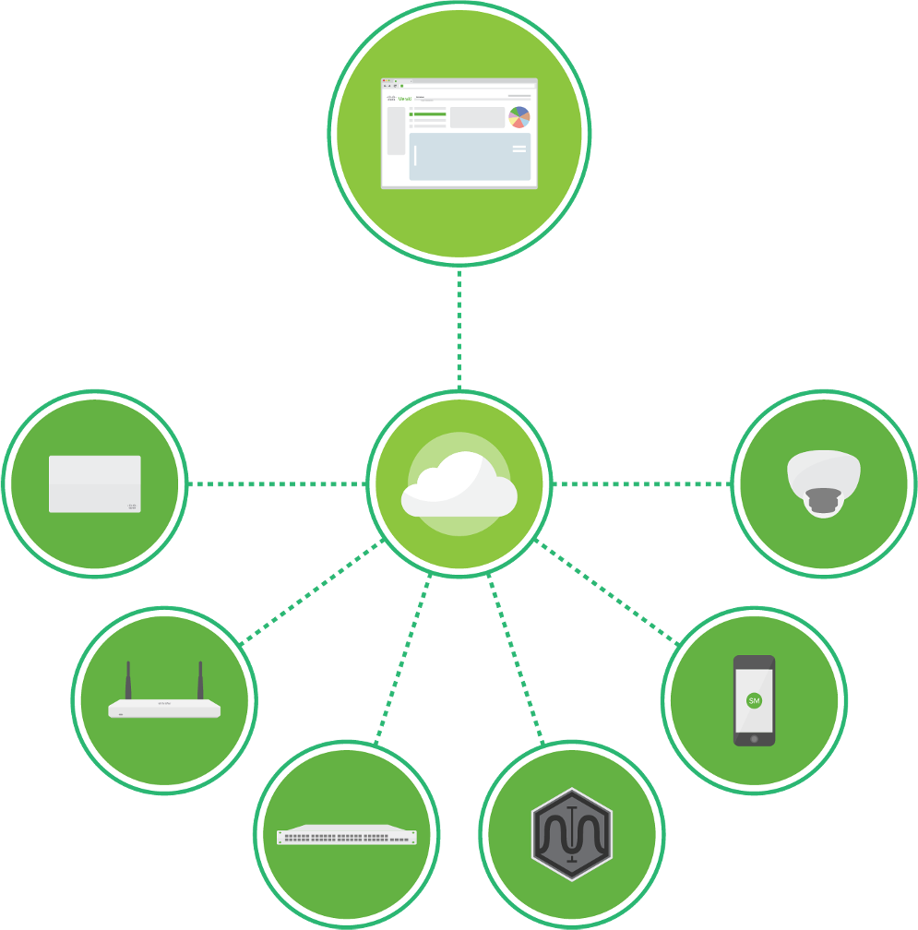
Простота управления IT
Полноценное решение для инфраструктуры с облачным управлением
Проводная и беспроводная сеть, безопасность, SD- WAN, аналитика, управление конечными устройствами, камеры
Оборудование, ПО и облачный сервис
Лидер облачных IT решений

Slide 4
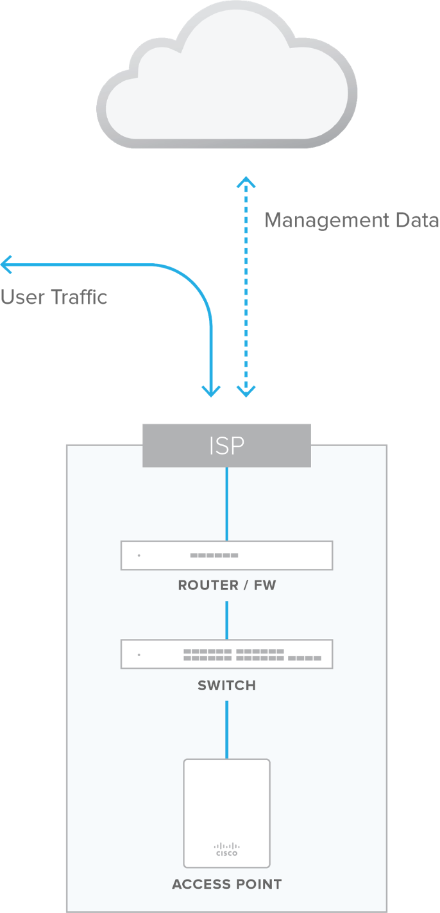
Облачное управление
Интуитивное
Простой веб-интерфейс
Централизованная облачная платформа
Масштабируемое
Нет узких мест
Быстрое добавление устройств
Надежное
Облачная система распределена между несколькими ЦОДами
Сеть работает даже в случае временной недоступности облака
99.99% SLA
Безопасное
Пользовательский трафик не передаётся в облако
Сеть может полностью соответствовать сертификатам HIPAA- / PCI- compliant
Регулярное тестирование и аудиты безопасности
Автоматическое обновление ПО(под контролем пользователя)
Больше информации по надежности и безопасности: meraki.cisco.com/trust

Slide 5

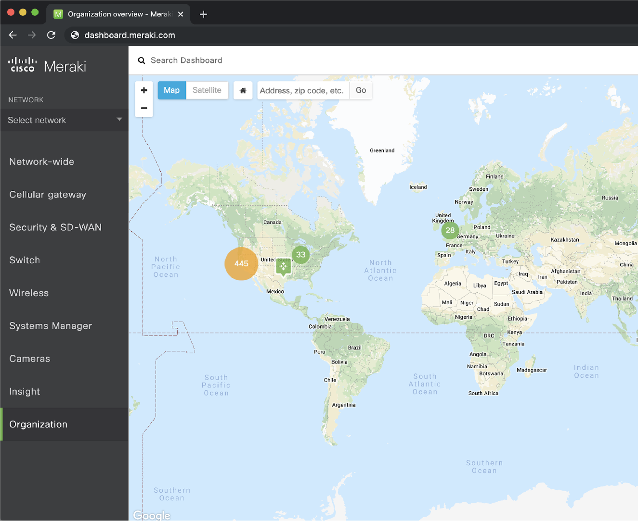
Интерфейс Мераки
(Dashboard)
Централизованное управление всеми устройствами
Интуитивный интерфейс
Централизованное управление обновлениями
Автоматизированная система оповещений, удаленное устранение неполадок
Разграничение прав доступа
Полная информация о работе всех участков сети

Slide 6

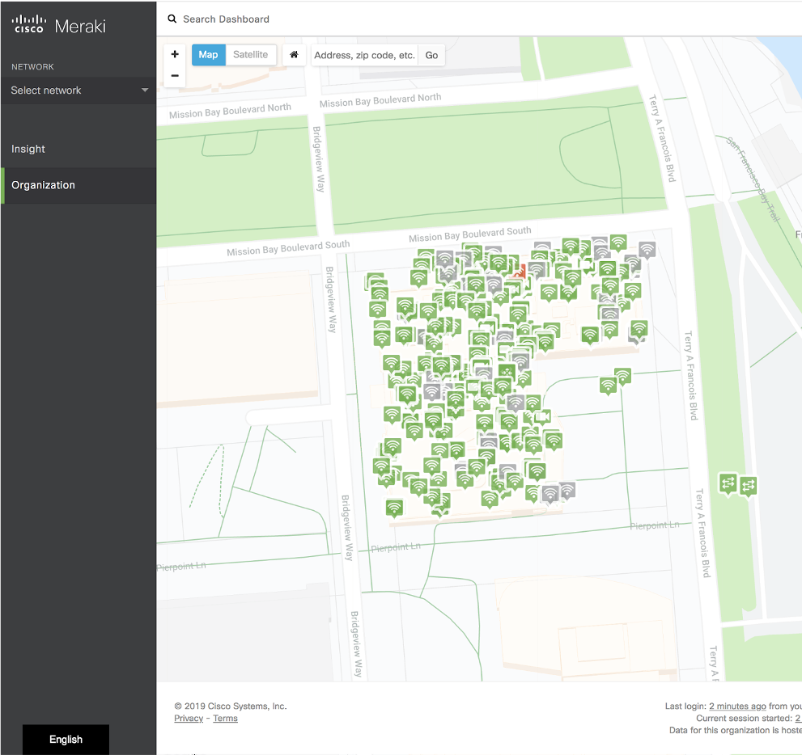


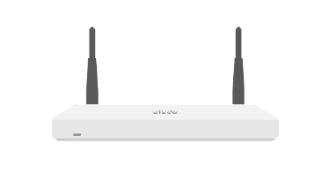

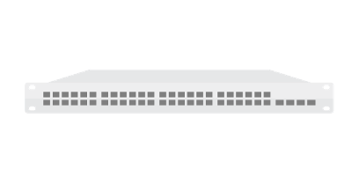



Портфолио: все компоненты сети и единый интерфейс управления
MR
Access Points
MG
Cellular Gateways
MX
SD-WAN & Security Appliances
MI
Insight & Optimized End-User Experiences
MS
Ethernet Switches
SM
Endpoint Management
MV
Smart Cameras
MT
Sensors

Slide 7

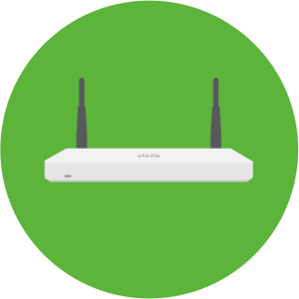



Система лицензирования «все включено»
1 устройство – 1 лицензия
Длительность лицензий: 1, 3, 5, 7, и 10 лет
Централизованное управление со встроенными средствами мониторинга и отладки
Обновления ПО
24/7 поддержка и гарантия
Все функции включены (при появлении новых функций достаточно обновить ПО)
Лицензия
Устройство

Slide 8
Simple, Secure, Optimized Connectivity
February 23, 2021

Slide 9
Strained Premium WAN Links
MPLS
CURRENT
AVERAGE COST OF MPLS
HQ / DC
BRANCH
$600
PER MBPS PER MONTH
MPLS
FUTURE
HQ / DC
BRANCH
● business critical ● non-critical
Устаревшие премиум-каналы WAN испытывают все большую нагрузку в результате роста бизнеса SaaS и межсайтового трафик
Увеличение пропускной способности частных WAN каналов является дорогостоящим вариантом для большинства организаций.

Slide 10
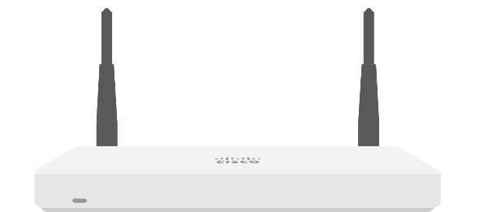
Future WAN Options
MPLS
MPLS ONLY
Increase the capacity of an existing MPLS network
1
HQ / DC
MPLS
BRANCH
BROADBAND
AUGMENTED MPLS
Supplement an existing MPLS network with broadband for increased bandwidth
Offload traffic from MPLS to broadband with policy based routing dynamic path selection
2
REDUCING COST
HQ / DC
BROADBAND
BRANCH
BROADBAND
BROADBAND-BROADBAND
Dual high speed broadband connections
Load balance business critical traffic based on policy or link performance
3
HQ / DC
BRANCH
● business critical ● non-critical
MERAKI SD-WAN

Slide 11
Cisco SD-WAN
POWERED BY MERAKI

Slide 12
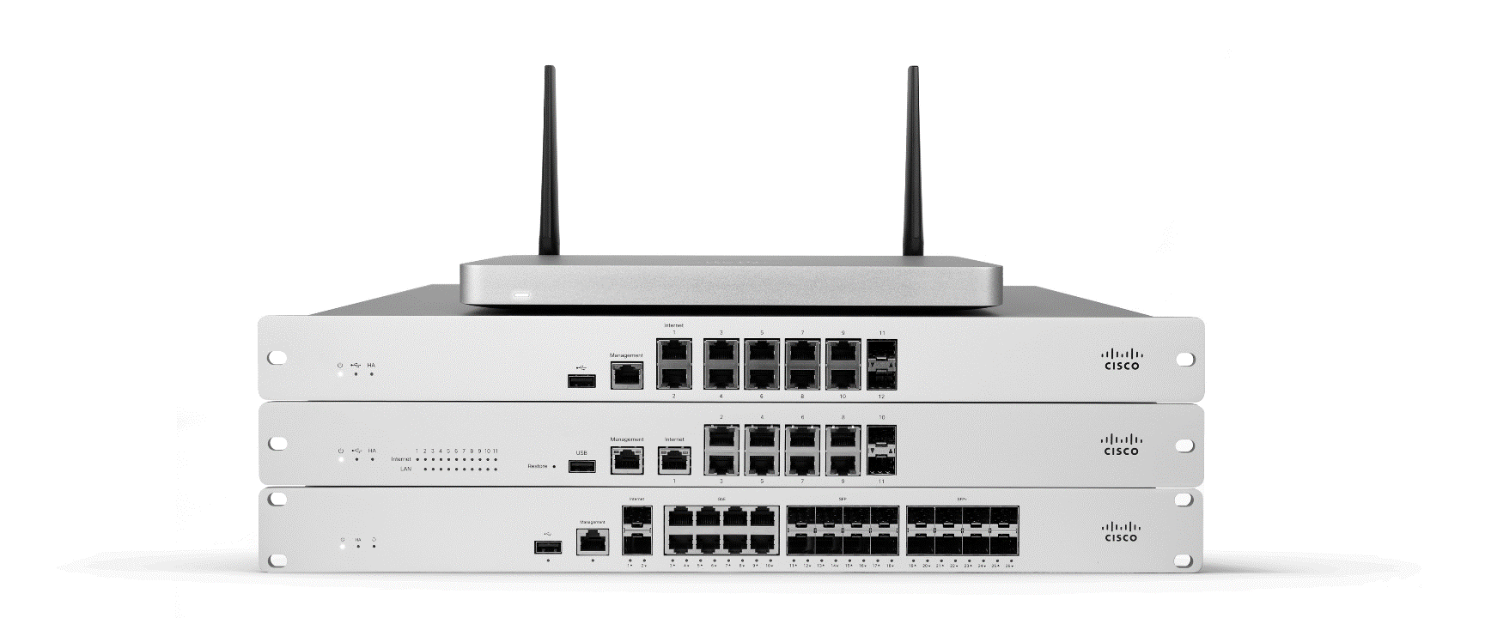






Delivered by Powerful Hardware
Hardware highlights across all MX models
  ×2 WAN ports
  3G / 4G / LTE USB as single-WAN or failover
  Additional Ethernet ports with PoE/PoE+ options
  Models with embedded LTE modem
  High availability mode
MERAKI MX SD-WAN & SECURITY APPLIANCES
AUTOMATIC WAN FAILOVER

Slide 13
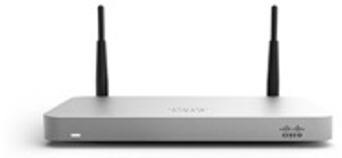


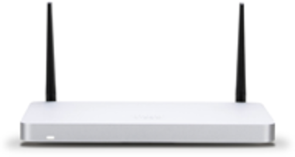
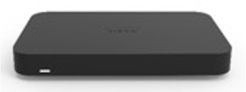
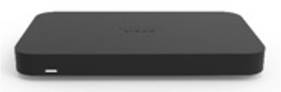




MX Portfolio
Teleworker
Small Branch
MX64
~50 users 802.11ac Wireless*
FW throughput: 250 Mbps
MX67/68
~50 users
802.11ac Wave 2* & PoE FW throughput: 450 Mbps
MX67C/68CW
~50 users
802.11ac Wave 2* & PoE FW throughput: 450 Mbps
CAT 6 LTE
Z3 Z3C
5 users
802.11ac Wave 2 Wireless & PoE FW throughput: 100 Mbps
CAT 3 LTE (Z3C)
Medium Branch
Large Branch, Campus or
Virtual
Concentrator
MX84
MX100
MX250
~2,000 users
FW throughput: 4 Gbps
MX450
vMX for AWS & Azure
FW throughput: 1 Gbps VPN & SD-WAN features
~200 users ~500 users
FW throughput: 500 Mbps FW throughput: 750 Mbps
~10,00 users
FW throughput: 6 Gbps
*Available with wireless models (MX64W, MX67W, MX68W, MX68CW)

Slide 14
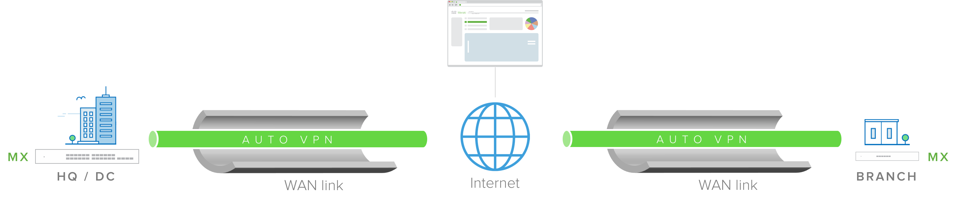
Securely Built on Site-to-Site Auto VPN
Meraki Auto VPN | The ability to configure site-to-site, Layer 3 IPsec VPN tunnels in just two clicks in the Cisco Meraki dashboard over any WAN link
Automatically configured VPN parameters | The Cisco Meraki dashboard uniquely acts as a broker between MXs in an organization, negotiating VPN routes, authentication and encryption protocols, and key exchange automatically to create hub-and-spoke or mesh VPN topologies
Redundancy built-in | MXs with two uplinks will automatically self-heal to re-negotiate VPN tunnels if a primary uplink goes down

Slide 15
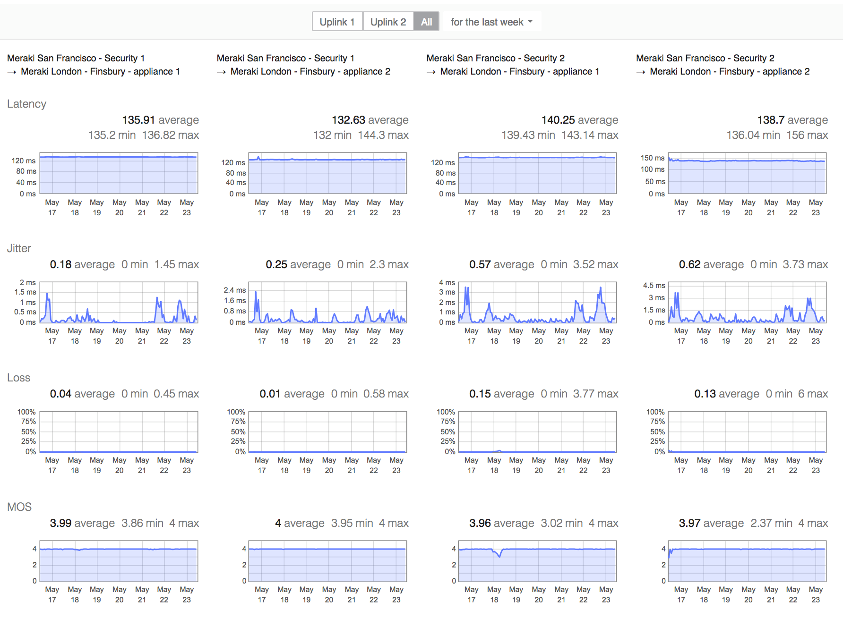
Driven by Real-Time VPN Performance Monitoring
Performance metrics of all site-to-site VPN routes are monitored and logged approx. every second
  Latency
  Jitter
  Loss
  MOS
This data is used to make intelligent decisions about WAN connectivity

Slide 16
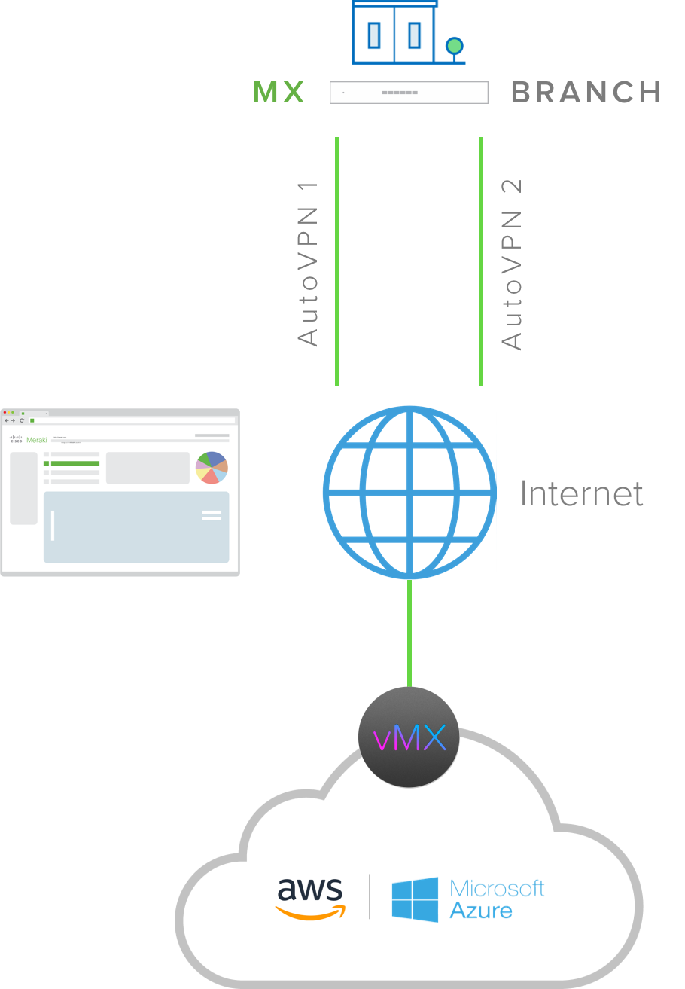
Extension to Public Cloud Services
Extend MX deployments to IT services located in AWS or Microsoft Azure with site-to-site auto VPN to a virtual MX (vMX)
Leverage SD-WAN on vMX the same way as a physical MX for optimal path selection to IT services hosted in AWS or Azure
vMX is managed just like any other physical MX in the dashboard once deployed on an AWS EC2 instance or an Azure VM
Only license required

Slide 17
Smart WAN Paths to Suit Your Business
Dual active VPN Load balance your VPN traffic over two WAN links
Policy-based Routing (PbR) Select the preferred path for traffic based on protocol, port, source and destination IP, or even application
Dynamic path selection Select the best VPN tunnel for traffic automatically based on performance

Slide 18





Licensing that fits the business’ needs
+
Enterprise
Essential SD-WAN features
Advanced Security
All enterprise features plus:
Secure SD-WAN Plus
All advanced security features plus: Advanced analytics with ML
Smart SaaS optimization Segmentation
Secure connectivity & basic security
Fully featured unified threat management
All I need is AutoVPN and a firewall
I connect to the internet, so I need UTM security as well
My business relies on apps served from SaaS/IaaS/DC

Slide 19

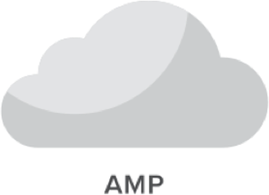

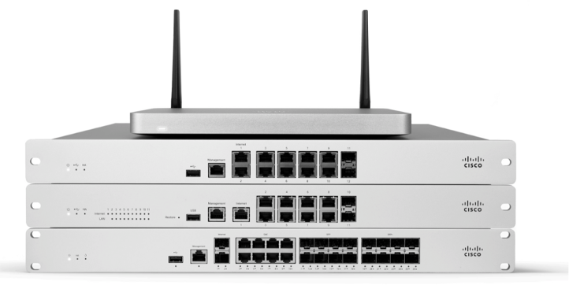





Интеграция безопасности / взаимодействие
Meraki Integrations
Meraki Interoperability
Meraki MX
Cisco ISE

Slide 20
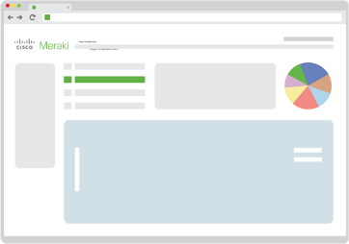


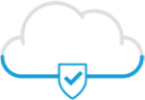








Использование решений Cisco для обеспечения безопасности
MR
Cisco IPS
MX
Umbrella
MS
AMP
MI
ISE
SM
Talos
MV
AnyConnect

Slide 21
SD-WAN+

Slide 22

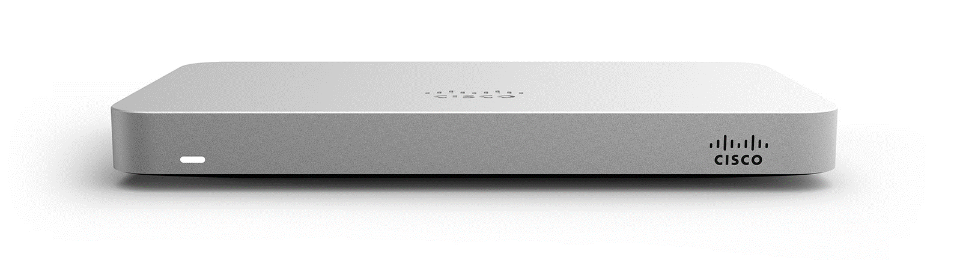
Meraki Insight
Also delivered by the Meraki MX

Slide 23
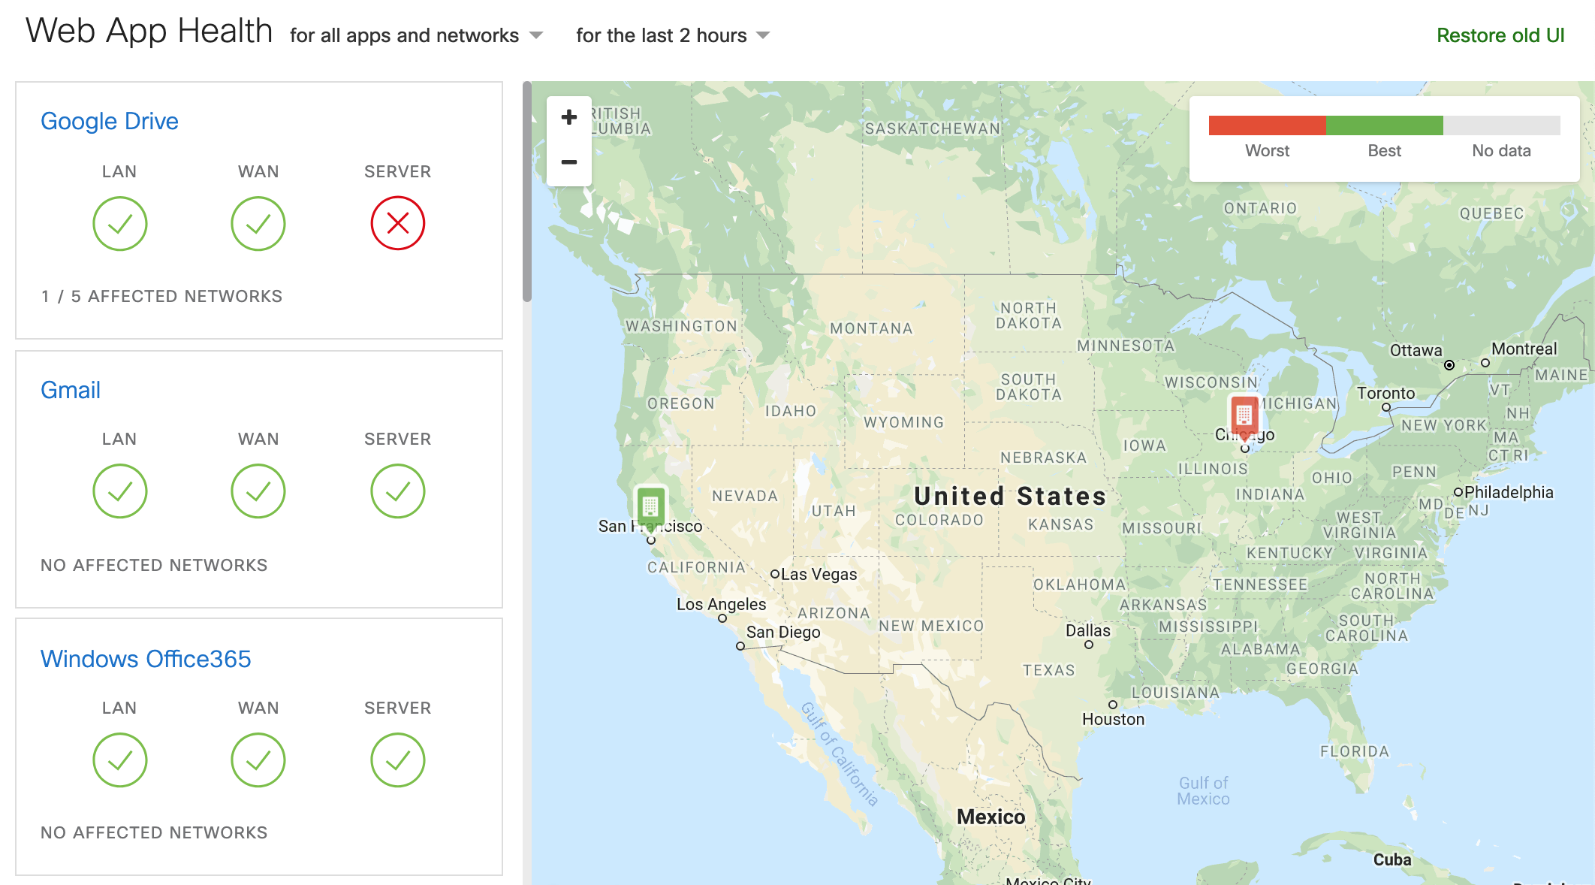
Web Application Experience
Monitor performance for apps travelling via VPN or public Internet
End-to-end visibility for SaaS application experience
Network performance analytics and troubleshooting, including the LAN, WAN, servers and domains
Accelerate IT and reduce time-to-resolution
End-to-end network intelligence at work
Ease migration to SaaS with simplified troubleshooting

Slide 24
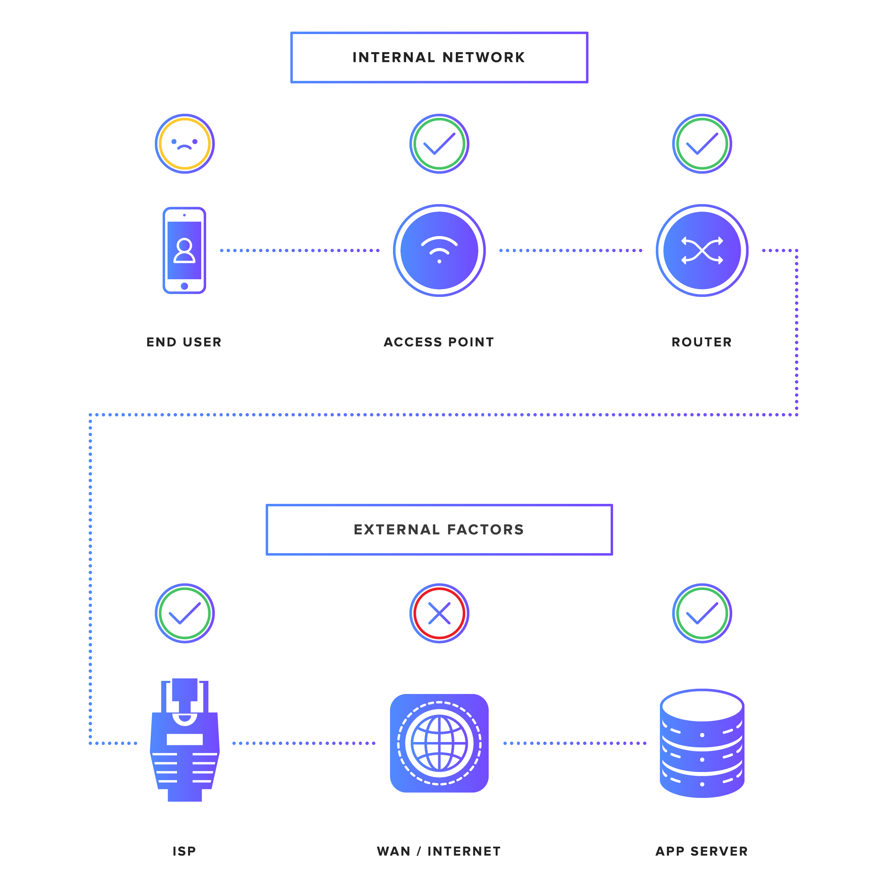

Web-based application analytics
Feature highlights
End-to-end visibility to SaaS applications
Application performance management Application performance troubleshooting Monitor network and application layers data
WAN Health monitoring
Offers data for external factors, including the entire WAN, ISPs and cloud applications like Office 365, Salesforce.com, etc.
At first, the MX is used as a probe for gathering data…

Slide 25
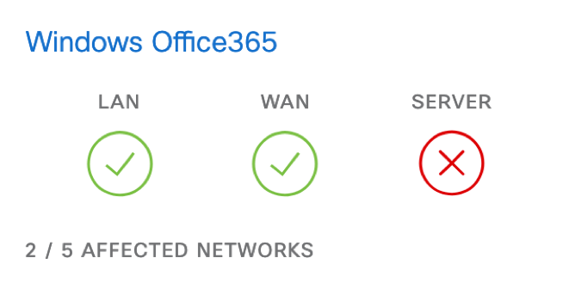
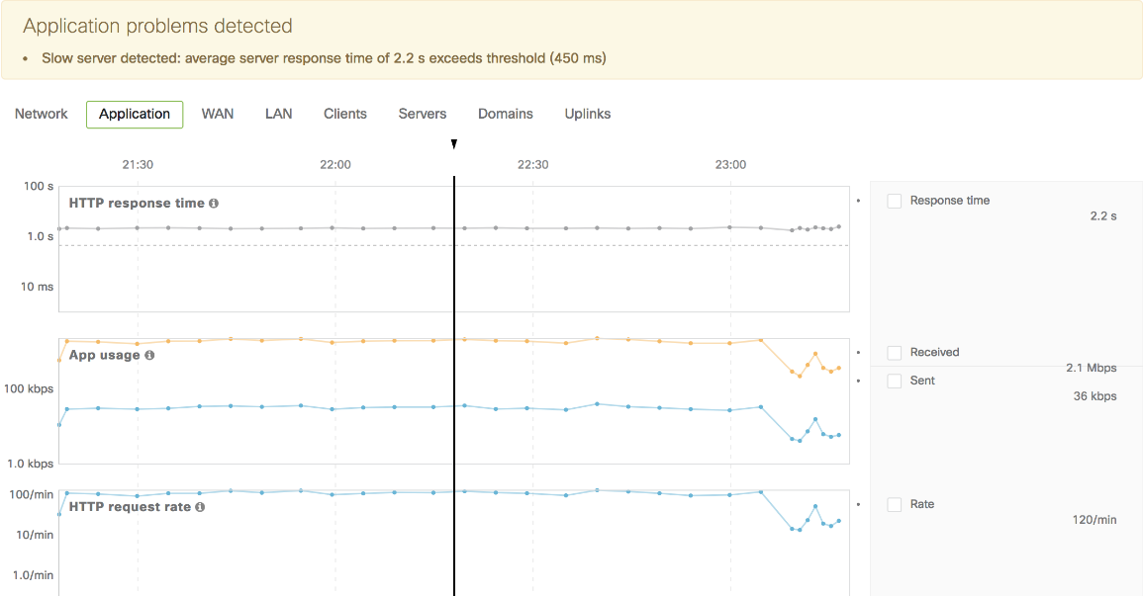
Pinpoint App Performance Issues in Minutes
Using MI an IT admin can immediately tell which point in the network is failing and causing degradation
Where’s the issue and so who should be contacted?
Within 2 clicks, an IT admin can understand the exact reason and drill down to generate specific evidence for the poor performance
What’s the exact reason and where’s the evidence?
Insight even suggests the root cause of performance issues

Slide 26
WAN Health
At-a-glance health of all MX uplinks across all sites
Quickly identify downed uplinks, including cellular across all sites
Easily monitor signal strength for cellular uplinks across all locations
Quickly isolate sites with underperforming uplinks to make the case for switching ISP or adding cellular as failover
Discover which sites are most reliant on cellular as failover
Monitor the health of all MX uplinks including cellular across all sites

Slide 27

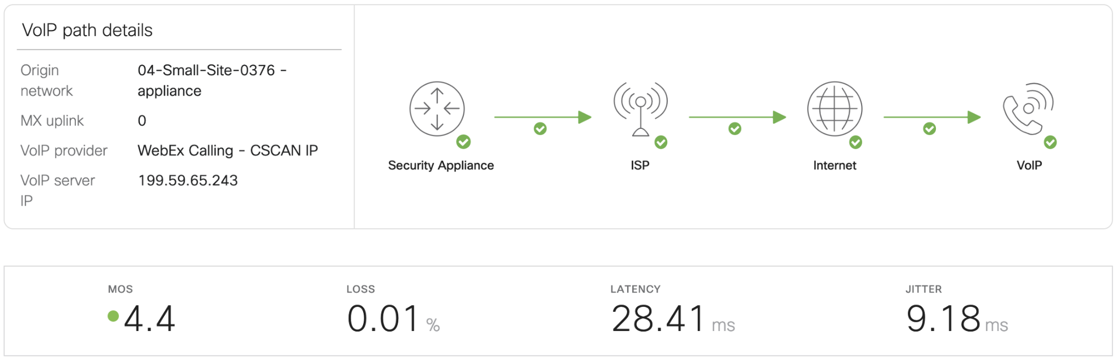
VoIP Health
#1 request for MI: why is my VoIP quality poor?
On-premise and cloud PBX: Cisco (Broadsoft), Skype/Teams, Ringcentral
~40% of customers who tried MI, but did not purchase, asked for VoIP support
No firmware limitation

Slide 28
Licensing
MX MODELS | LICENSE SIZE FW Throughput
Z3x | EXTRA SMALL Up to 100 Mbps
MX6x | SMALL Up to 450 Mbps
MX84 | MX100 | MEDIUM Up to 750 Mbps
MX250 | LARGE Up to 5 Gbps
MX450 | EXTRA LARGE Up to 10 Gbps

Slide 29
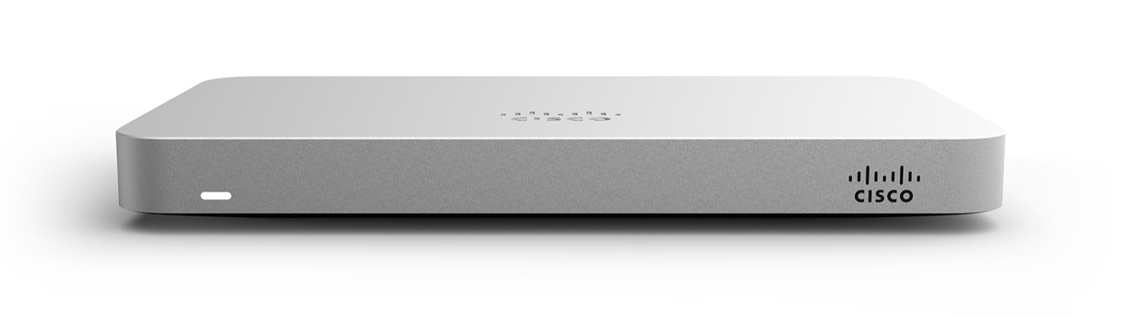
MI does not need any additional hardware
Meraki MX: built in collector for MI

Slide 30
Deployment Scenarios

Slide 31
VPN Traffic
OPTION 1: MX-MX (hub-and-spoke)
 | MXs at branch sites establish auto VPN tunnels with an MX at the HQ / DC Real-time performance of VPN tunnels is measured Traffic is routed to the HQ / DC based on the real-time performance of the auto VPN tunnels
OPTION 2: MX-to-3rd Party Peers (hub-and-spoke*)
 | MXs at branch sites establish VPN tunnels with a 3rd party peer at the HQ / DC Real-time performance of VPN tunnels is measured leveraging the packet loss and latency API end points Traffic is routed to the HQ / DC via a designated primary VPN tunnel and failover occurs if loss/latency exceeds thresholds
* [This option also allows for data center failover]

Slide 32
Direct Internet Access
Branch sites accessing cloud applications over a public Internet link
Shorter route than backhauling | Removes security normally provided by the DC / HQ
Recommended by SaaS providers | No visibility beyond the LAN

Slide 33





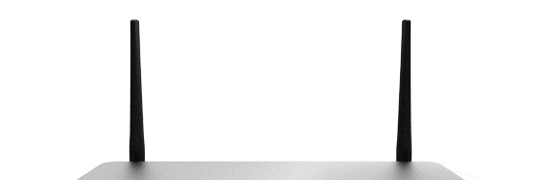
Direct Internet Access
MX
HQ / DC
MX
+
MI
BRANCH
LAN
WAN
SERVER
All-in-one: Secure SD-WAN and advanced visibility
              MX delivers enterprise security directly at the branch
              Meraki Insight provides deep visibility beyond the LAN
              Track client experience for business critical web applications
              Receive real-time alerts for performance degradation
              Pinpoint root cause of performance issues in minutes

Slide 34
What’s Needed

Slide 36
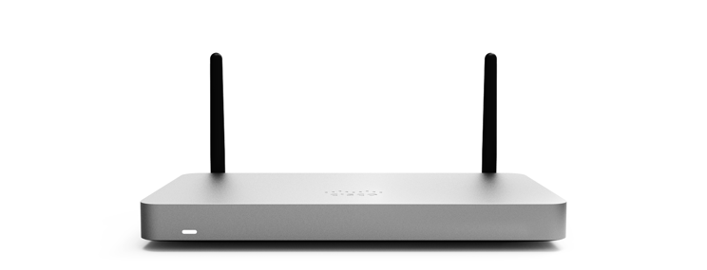
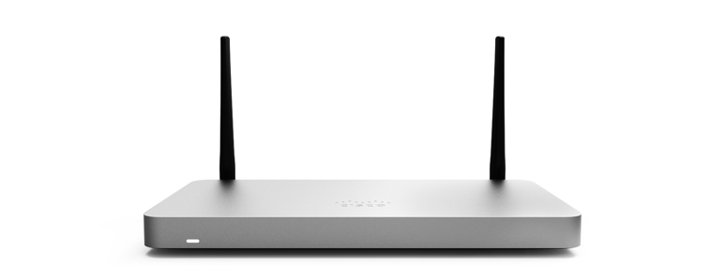

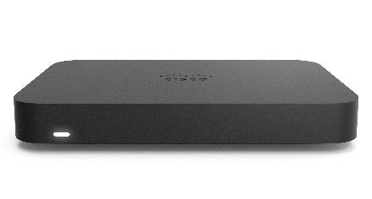
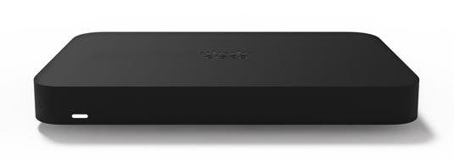




A Model for Every Location
SMALL BRANCH
TELEWORKER
MX64/65 | MX67/68 | MX67C/68CW
~50 users 802.11ac Wireless* & PoE FW throughput: 250 Mbps | ~50 users 802.11ac Wave 2* & PoE FW throughput: 450 Mbps | ~50 users 802.11ac Wave 2* & PoE FW throughput: 450 Mbps CAT 6 LTE
Z3 | Z3C
~5 users 802.11ac Wave 2 Wireless & PoE FW throughput: 100 Mbps CAT 3 LTE (Z3C)
MEDIUM BRANCH
LARGE BRANCH, CAMPUS OR CONCENTRATOR
VIRTUAL
MX84 | MX100
~200 users FW throughput: 500 Mbps | ~500 users FW throughput: 750 Mbps
MX250 | MX450
~2,000 users FW throughput: 4 Gbps | ~10,000 users FW throughput: 6 Gbps
vMX for AWS & Azure
FW throughput: 1 Gbps VPN & SD-WAN

Slide 37
SD-WAN
For a multi-cloud world

Slide 38
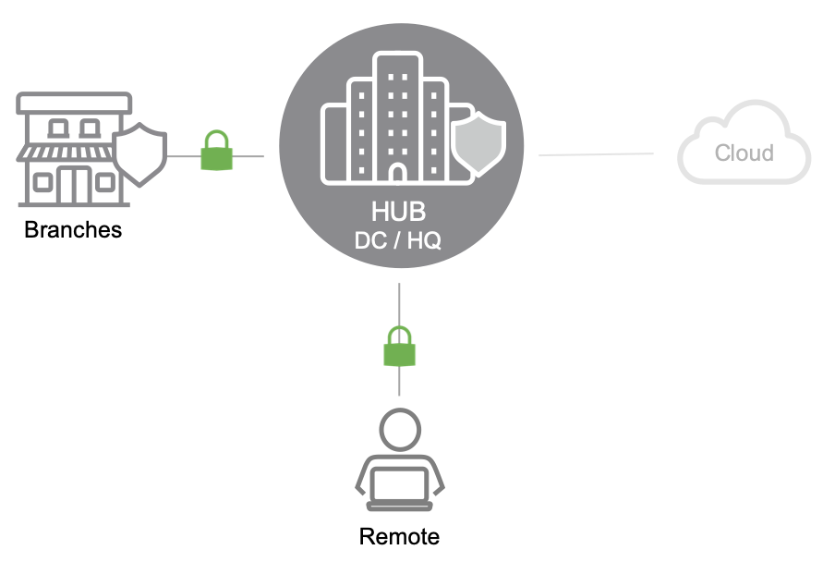
HUB-CENTRIC CONNECTIVITY
Yesterday
Resources were primarily hosted in the data center
Secure and optimized connectivity to the hub was key
Resources and workloads in the cloud were limited
and non-critical

Slide 39
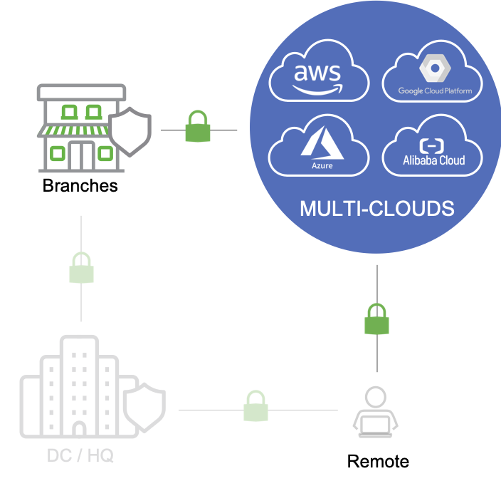
MULTI-CLOUD CONNECTIVITY
Today
Resources and workloads are moving from on-prem data centers
Business-critical resources and workloads are increasingly
hosted in multiple cloud environments
Seamless and optimized access to relevant clouds is key

Slide 40

Introducing a complete public cloud portfolio

Slide 41
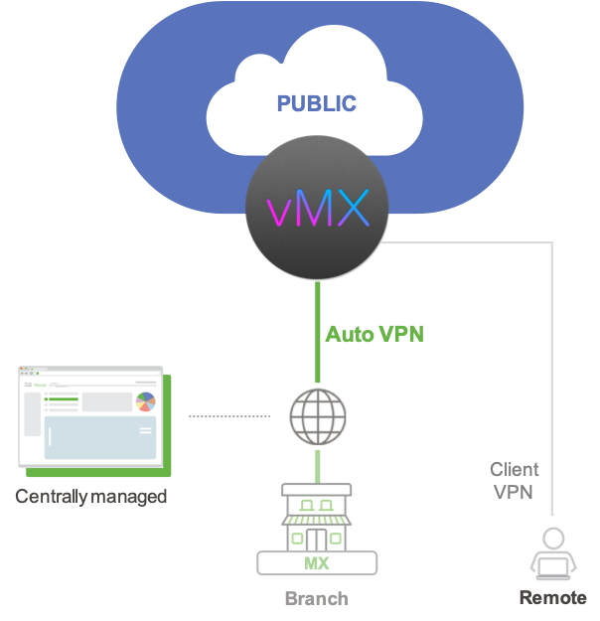
Delivered by a Virtual
MX Appliance
MERAKI vMX
vMX is designed to extend the simplicity of site-to-site Auto VPN to
public cloud environments
Extend the Meraki SD-WAN fabric to public cloud environments for optimized access to business-critical resources
Securely connect branch sites with a physical MX appliance to resources in public cloud environments in three clicks with Auto VPN
An Auto VPN tunnel to a vMX is like having a direct Ethernet connection to a private data center
Supports client VPN for remote users

Slide 42
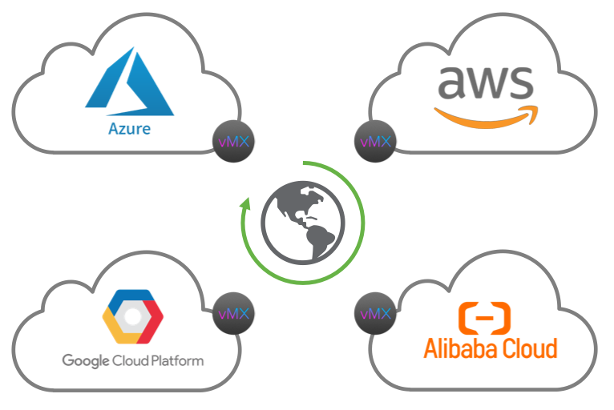
MERAKI vMX PUBLIC CLOUD
Global Support for all Major Public Clouds
Supported public cloud providers
  Microsoft Azure
  Amazon Web Services (AWS)
  Google Cloud Platform (GCP)
  Alibaba Cloud
Global coverage
  Incl. AWS China + C5 regions

Slide 43
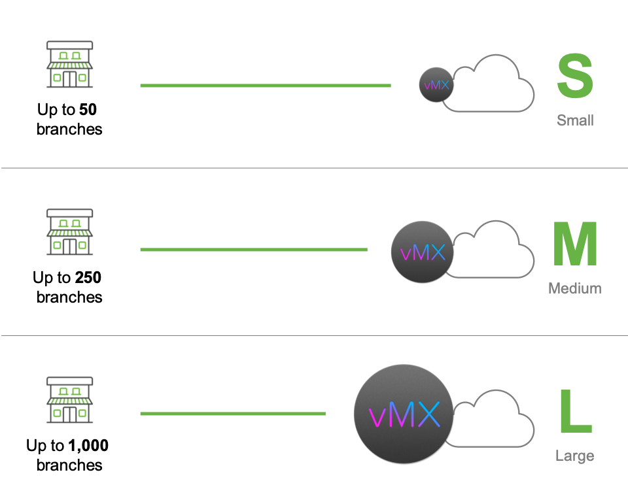
MERAKI vMX PUBLIC CLOUD
Sized to Fit
vMX is available in three sizes to deliver cost- effective cloud connectivity across a wide range of use cases
  Small
  Medium
  Large

Slide 44
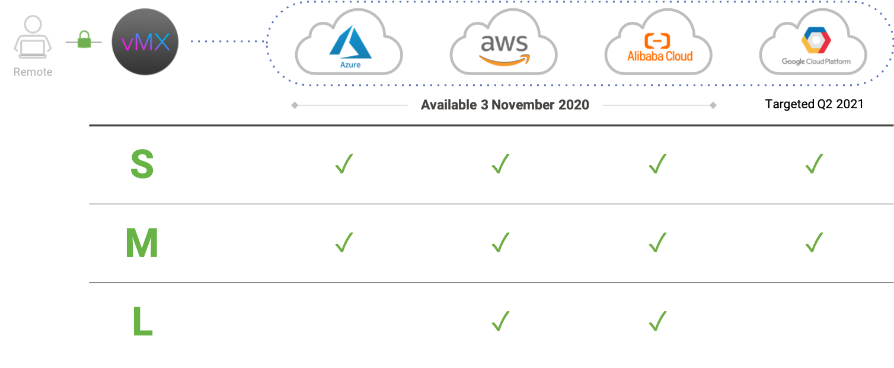
SD-WAN Simplicity Extended to Multi-Cloud
MERAKI vMX PUBLIC CLOUD PORFOLIO

Slide 45
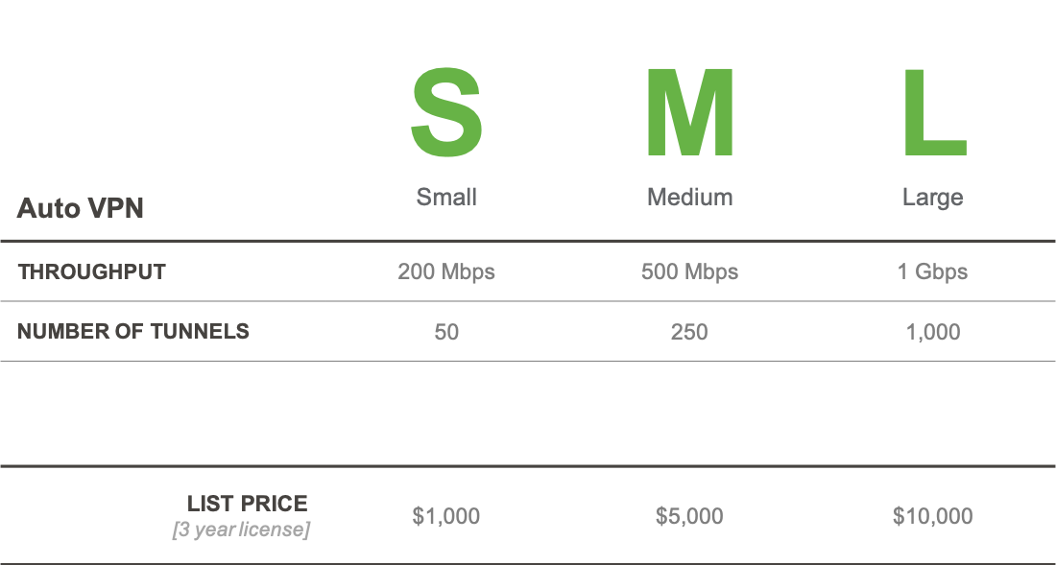
Specifications
MERAKI vMX PUBLIC CLOUD PORFOLIO

Slide 46
Cisco Meraki MR & Cisco Umbrella integration

Slide 47
Как обезопасить каждого пользователя Вашей сети в считанные минуты?

Slide 48
Технология интеграции
Meraki MR
100% cloud-managed wireless access points
Umbrella
Cloud-delivered secure internet gateway
Manage your global wireless infrastructure from a single dashboard.
Provides visibility into application, device, and usage statistics.
No controller hardware to install or maintain.
Protection against threats such as malware, ransomware, & C2 callbacks with no added latency.
Visibility into internet activity across all locations and users.
No hardware to install or software to manually update.
Notes:
Cisco Meraki MR
Series of 100% cloud-managed wireless access points
With Meraki MR, you can manage your global wireless infrastructure from a single dashboard.
You’ll gain visibility into application, device, and usage statistics for your network.
Unlike other solutions, there is no controller hardware to install or maintain
Cisco Umbrella
Cloud-delivered secure internet gateway
Umbrella provides protection against threats such as malware, ransomware & C2 callbacks with no added latency.
You’ll gain insights into internet activity across all locations and users.
No hardware to install or software to manually update.

Slide 49
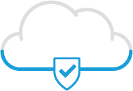
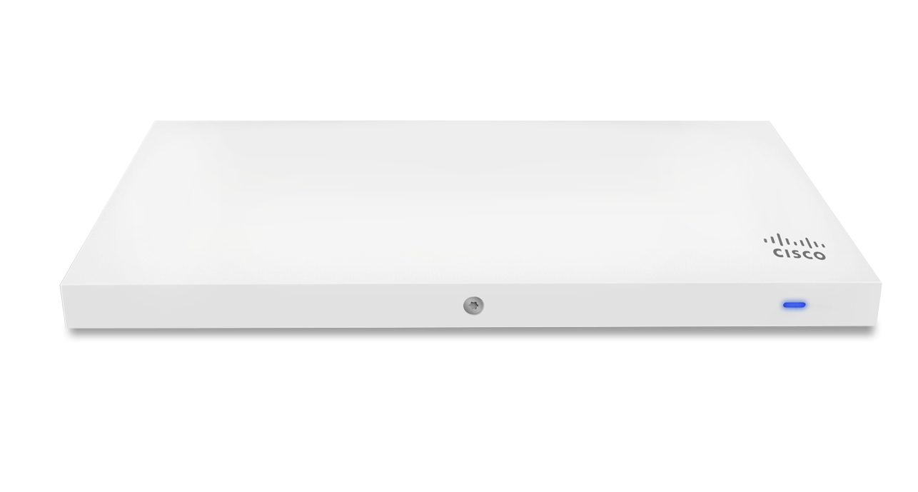
Выгоды
Самый простой способ развернуть Umbrella в беспроводной сети.
Удобно включайте политики Umbrella прямо в Meraki Dashboard.
Детализированные политики для каждого SSID или с помощью групповых политик Meraki.
Umbrella
+
Meraki MR
Notes:
Why should you care about this integration?
It is the simplest way to deploy Umbrella across a wireless network.
From within the Meraki dashboard, you can enable Umbrella policies, adding a new level of convenience.
The integrations allows you to create policies on a per-SSID basis or by using Meraki group policies. This provides additional granularity when creating and managing policies.

Slide 50




Meraki MR + Cisco Umbrella
Meraki MR
ADVANCED & UPGRADE LICENSE
Zero touch DNS traffic protection and content filtering
Available on Wi - Fi 6 APs and APs with Firmware MR26.x+

Slide 51
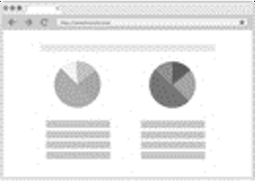
Better Together (MR + Umbrella)
Meraki MR
Secure WiFi
Define Umbrella policies to protect corporate users, guest wifi and BYOD
Dashboard Linkage
Link Meraki Dashboard directly to the Umbrella account via API
Policy Flexibility
Assign Umbrella policies to Meraki wireless networks, per- SSID or Meraki Group Policy
Requires MR version 26

Slide 52

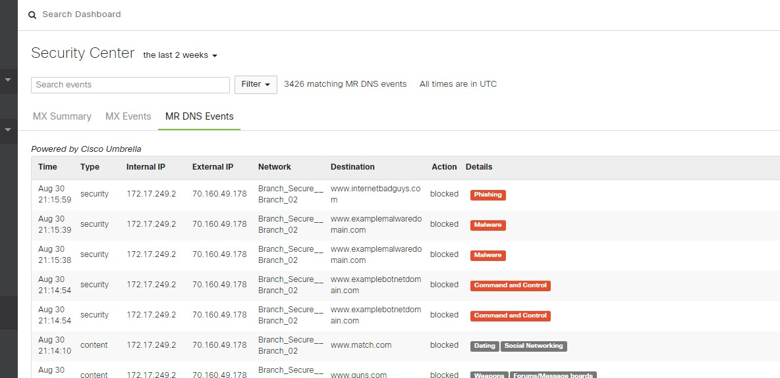
Umbrella security events in Dashboard
Meraki MR

Slide 53
Two ways to enable DNS Security with Meraki
Meraki MR
MANUAL API INTEGRATION AUTOMATED INTEGRATION
Two license, Two solutions One license, Two solutions
Benefits:
Benefits:
Access to all Umbrella policies & custom features
Granular visibility into network events
Access to the Umbrella dashboard
Turn-key solution, no integration required
Faster provisioning and simplified licensing
View DNS events in the Meraki dashboard
Challenges:
Challenges:
Manual API integration
Managed using two dashboards
DNS events only visible in Umbrella dashboard
No option to create custom policies
Access to Umbrella dashboard is not available
Only broad overview of DNS events
For:
Customers who want to build custom policies
Customers who want to deploy niche policies for compliance
For:
Customers seeking to deploy basic DNS security
Customers who want to provide guest Wi-Fi with ease
SKU Names:
Advanced licence new MR users
Upgrade license for existing MR users
SKU Names:
Individual License SKUs for MR
Individual License SKUs for Umbrella

Slide 54
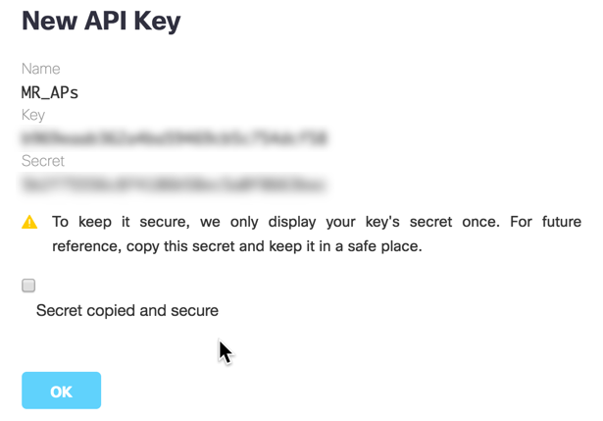
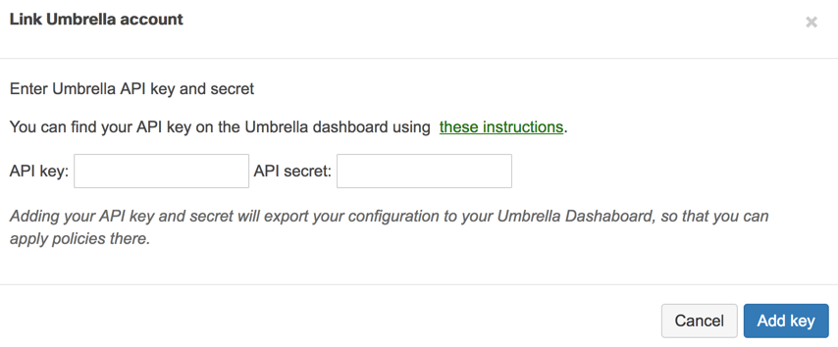
How it works
Step 1 (Umbrella dashboard)
Copy API key and Secret.
Step 2 (Meraki dashboard)
Input API key and secret.
Notes:
How does it work?
First, in the Umbrella dashboard, you’ll copy the API Key and Secret. The API Key and Secret are tokens that authenticate and connect your Umbrella account to Meraki.
Once you have copied the API Key and Secret, you will input them into the Meraki Dashboard.

Slide 55
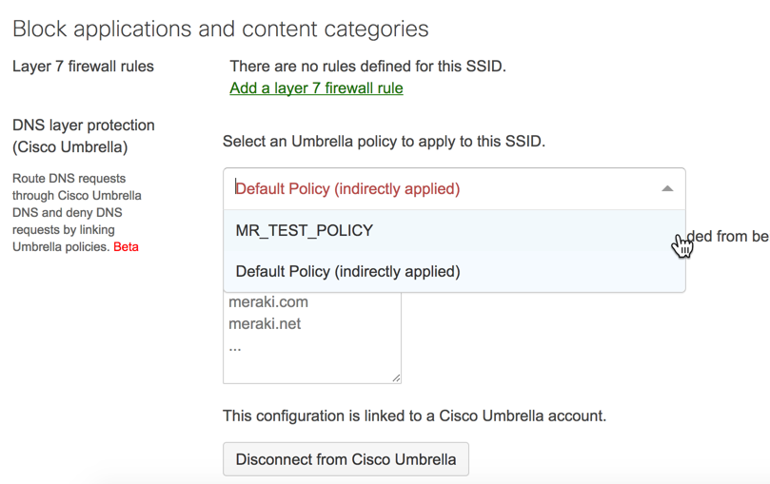

How it works
Step 3 (Meraki dashboard)
Apply Umbrella policy.
Step 4
That’s it. Seriously, it’s that easy.
Notes:
Next,
You’ll select the Umbrella policy you want to use. Once a policy is selected, You’re done. Umbrella is now deployed across your SSID.

Slide 56
Deployment
Protect corporate and guest wi-fi
Inserts Device ID and Client IP in EDNS request and forwards
EMPLOYEE WI-FI SSID
Meraki access points
208.67.222.222
Your policy
Enforce Umbrella security settings per SSID or using Meraki Group Policies
Network egress IP
67.215.87.11
Employee Wi-Fi
SSID DNS server
208.67.222.222
Guest Wi-Fi SSID
DNS server
208.67.222.222
GUEST WI-FI SSID
YOUR NETWORK
Notes:
Here is an example of a possible deployment scenario. In This Scenario, Umbrella is deployed across the entire network including the Guest Wi-Fi SSID and Employee Wi-Fi SSID.

Slide 57
Where does Umbrella fit?
Malware
C2 Callbacks
Phishing
Umbrella
    Benefits
    Block malware before it hits the enterprise
    Contains malware
    if already inside
    Internet access is faster
    Provision globally in minutes
First line
NGFW
Netflow
Proxy
Sandbox
Router/UTM
AV
AV
AV
AV
AV
HQ
BRANCH
ROAMING
Notes:
Think about where you enforce security today.
Questions to pose: What do you use to protect your network? Your endpoints?
You probably have a range of products deployed at your corporate headquarters and branch offices, or on roaming laptops.
There are many ways that malware can get in, which is why it’s important to have multiple layers of security.
Umbrella + DNS:
Umbrella can be the first layer of defense against threats by preventing devices from connecting to malicious or likely malicious sites in the first place—which significantly reduces the chance of malware getting to your network or endpoints.
We use DNS as one of the main mechanisms to get traffic to our cloud platform, and then use it to enforce security too.
DNS is a foundational component of how the internet works and is used by every device in the network.
Way before a malware file is downloaded or before an IP connection over any port or any protocol is even established, there’s a DNS request.
Let’s look now at the key features for Umbrella.

Slide 58
It all starts with DNS
DNS = Domain Name System
First step in connecting to the internet
Precedes file execution and IP connection
Used by all devices
Port agnostic
Umbrella
Cisco.com
72.163.4.161
Notes:
With Umbrella, it all begins with DNS — We use it as the main mechanism to get traffic to our cloud platform for inspection.
Now everyone has probably heard of DNS, but lets level set on what it is, and why it’s so important with Umbrella.
DNS is the domain name system, and it’s used to map domain names like cisco.com to an IP address.
Think about when you want to call your friend or colleague. You’ll look up their name in your contact list, instead of trying to remember everyone’s phone number. DNS was developed for a very similar reason — so you wouldn’t need to remember the IP address for every website you want to visit.
DNS is the first step in nearly all internet connections, and it’s used by all devices. So with Umbrella, we’re trying in to something you’re already doing. Any time you click on a link or type a URL for an external site, the request goes to a recursive DNS service, like Umbrella, to look up the IP address.
So, Umbrella will resolve the DNS request, plus add security at the same time — all without adding any latency. In fact, many customers report better internet performance after switching to Umbrella.
With Umbrella, it all begins with DNS — We use it as the main mechanism to get traffic to our cloud platform for inspection.
Now everyone has probably heard of DNS, but lets level set on what it is, and why it’s so important with Umbrella.
DNS is the domain name system, and it’s used to map domain names like cisco.com to an IP address.
Think about when you want to call your friend or colleague. You’ll look up their name in your contact list, instead of trying to remember everyone’s phone number. DNS was developed for a very similar reason — so you wouldn’t need to remember the IP address for every website you want to visit.
Why is this so useful for security?
1. DNS used by all devices, every time the device connects to the internet,
Tying into something that organizations already doing
They’re already relying on someone for recursive DNS, most likely their ISP, so we’re doing that, PLUS adding security (without adding any latency)
2. Turns out this same mechanism is also useful for finding malicious destinations on the internet, and stopping devices from connecting there

Slide 59
What sets Umbrella apart from competitors
Fastest
and most reliable cloud infrastructure
Broadest
coverage of malicious
destinations and files
Most open
platform for integration
Easiest
connect-to-cloud deployment
Most predictive
intelligence to stop threats earlier
Notes:
Before we review Umbrella features in great detail – let’s quickly review what sets us apart from competitors.
Fastest and most reliable cloud infrastructure
When customers connect to a cloud security platform, performance is critical. It cannot break or slow down internet connections. Since our network was established in 2006, we’ve had 100% uptime. And not just that, but we have peering relationships with over 500 ISPs which allow us to resolve requests faster – most customer actually report a boost in speed.
Most open platform
Leveraging our bi-directional API, customers can easily integrate Umbrella with existing tools to automatically add to our platform or enhance another system – extending protection and enhancing information.
Most predictive intelligence
Our unparalleled intelligence enables us to uncover malicious domains, IPs, and URLs before they’re even used in attacks.
Easiest deployment
There’s no hardware to install or software to manually update, and customers can leverage their existing Cisco footprint to provisions thousands of network devices and laptops.
Broadest coverage of malicious destinations and files
Now, not only do we have the power of the malicious domains and IPs that we had in Umbrella before, but we also have coverage for malicious files that are attempted to be downloaded from risky domains - and this is through the power of AMP.

Slide 60


McDonalds Worldwide
Company Description:
McDonalds is the largest franchise fast food restaurant group in the world with over 1,300 restaurants across the UK and Ireland
Industry Vertical: Fast Food Restaurants
Challenge:
McDonalds UK are using technology to transform their restaurants, improving customer experience, delivering world class services through automation using IOT and AI.
With over 1,400 UK sites, they need a platform to manage multiple discrete networks such as guest, corporate, IoT etc in a simple, secure, easy to deploy and operate solution. The Meraki single Dashboard gives them this capability and enables them to bring guest services inhouse.
McDonalds are moving to SD-WAN, this deal enabled an early refresh of their WAN contract and supported their requirement for for 3G/4G LTE for really remote sites and failover.
Outcome: LAN, SD-WAN and WIFI implementation utilizing
Meraki MX, MS ,MR plus ISR refresh
The ability to roll out across all sites in less than three months and have true visibility of all devices, users, clients and application across all of the UK Sites via one single Dashboard.
Notes:
Winning Team:
Next Steps / Upsell
Team involved
Dominic Pierce Cisco Dir
Kam Patel Cisco RSM
Binit Shah Cisco AM
Andy Burnett Cisco SE
Richard Cairns Meraki PSS
Steve Corley Meraki CSE
Brett Martin Meraki DSE
Steve Harrison Meraki CSE
Chris Devereux, Meraki CSE
Dimitrie Sandu Meraki Partner CSE
Ashley Poundall Meraki Dir
Next Steps.
Meraki MV for ANPR, Queue data, Flow and dwell data. All part of McDonalds ambitions for automation plus Meraki Insight in all sites for application visibility

Slide 61

У вас есть технические вопросы?
вы хотите назначить встречу один на один..
или попробовать продукцию Meraki бесплатно?
→ Daniela Di Gioia
Cisco Meraki
dadigioi@cisco.com

