Slide 1
Использование искусственного интеллекта FortiAI для противодействия известным и неизвестным угрозам

Slide 2
Развитие угроз и вектор атак
Ai
Sandbox
SIEM
NGFW (AV/IPS/IDS)

Slide 3





Что такое DNN?
Классификация пчёл
Вывод
Обучение AI
Пчела обыкновенная
Пчела медовая

Slide 4





AI модель: Deep Neural Networks (DNN)
DNN - это ANN c двумя или более слоями между вводами и выводами для построения сложных взаимосвязей
Обучение AI
Классификация объектов
Вывод машины:
ANN №1
Категории пчёл
Пчела обыкновенная
Пчела медовая
ANN №2
Время дня
Пчела медовая собирает нектар в солненный день с подсолнуха однолетнего
День
Ночь
ANN №3
.
Тип местности
.
.
ANN №

Slide 5
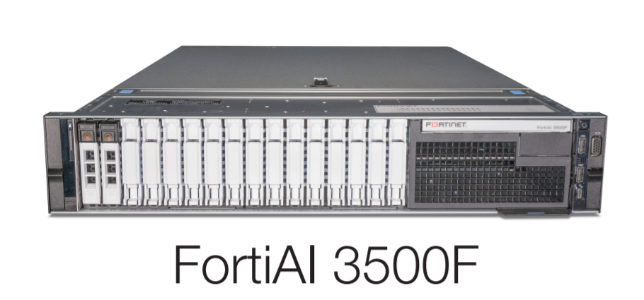
FortiAI
99.9%*
<100 ms
Обнаружение в миллисекундах
Рейтинг обнаружения угроз*
10G
100K
Пропускная способность
Файлов / час
FortiAI Virtual Security Analyst TM
(Виртуальный Ассистент по безопасности) Оснащён FortiAI’s Artificial Neural Networks (ANN), обнаруживает
Атаки Нулевого Дня
20+
Вариантов разития атак
* Measured by Breaking Point malware strike pack
Notes:
These are some of the stats of the ANN and Virtual Security Analysts.
While in FortiGuard Cloud VSA is exposed to 200Billion+ features, in the FortiAI solution we extract the HIGHEST QUALITY FEATURES (~6million) onto the appliance (while maintaining the best detection rate)

Slide 6
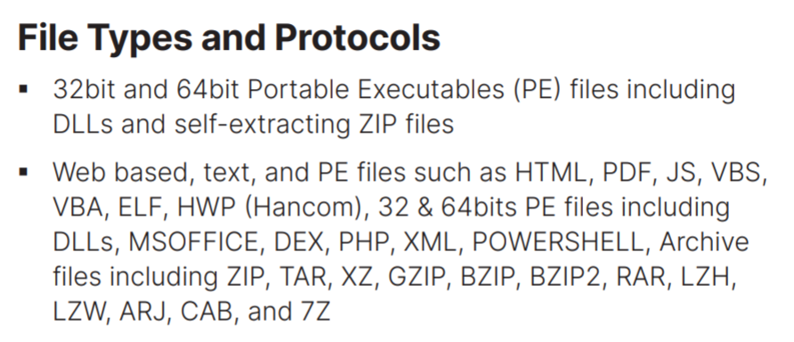



FortiAI – поддержка файлов
Доступно в:
FortiAI 3500 – 100 тыс. файлов в час
VM 14 – 22 тыс. файлов в час.
PHP
XML
Powershell
V1.5.1
* Measured by Breaking Point malware strike pack
Notes:
These are some of the stats of the ANN and Virtual Security Analysts.
While in FortiGuard Cloud VSA is exposed to 200Billion+ features, in the FortiAI solution we extract the HIGHEST QUALITY FEATURES (~6million) onto the appliance (while maintaining the best detection rate)

Slide 7


FortiAI Ключевые особенности
Интеграция с Security Fabric
Virtual Security
AnalystTM
Breach
Prevention
Блокировка & Карантин с FortiGate
REST API for submission
Поддержка FortiAnalyzer/FortiSIEM
Интеграция FortiSandbox (мощный pre-filter)
SYSLOG / ICAP для 3rd party
Отслеживание начала атаки
Виртуальный аналитик безопасности
Локальное самообучение
Вердикт за секунду
Расследование угрозы
Big Picture анализ
Attack Scenarios
Notes:
FortiAI’s ML is aim to:
- Increase performance, reducing detection time of sophisticated malware from minutes to sub-second
We have seen the progression of malware evolution, FortiAI ANN evolves to learning from training, and also on-prem learning from customers traffic (will cover this later slide 28)
It’s also business outcome focused based on Virtual Security Analyst, mimicking human intensive functions and experience, such as classify malware and tracing source on infection.
ON prem learning – there’s a slide for it later

Slide 8
FortiAI – что внутри
Патент # U.S. Serial No.: 16/053,479
Нейронная сеть
Обучена на 200+ миллионах файлов
Изучены миллиарды признаков
Каждый узел обозначет “Аналитика”
Функция – сравнение с признаками ВПО
База признаков состоит из:
  PE признаки (Portable Executables) и Non-PE признаки
  Техник, таких как анализ файловых значений реестра, запущенных процессов и тд.
Не требует запуска файла
Слой ввода
Слой вывода
1 слой ANN
6 + миллионов узлов
Notes:
Under the hood, FortiAI has a patent pending Artificial Neural Networks responsible for classifying the files, and scenario based engine (mentioned earlier) for tracing source of attacks.
The state of the art ANN is pretrained in FortiGuard labs with about 20mil clean and malicious files, and can be further trained at customer site (slide later).
To understand the ANN, you can imagine each “node” is a job for a ‘junor’ analyst, trying to determine if a code block matches any known malicious behavior.
The input of the ANN is code blocks and output is a verdict of file (clean/malicious) based on the features observed.
Also important to note there’s no need to *run* the file like traditional sandboxing. This cuts down and reduce time for processing.
PE = portable executables ie. Exe MS type files
Non PE = scripts, text based web traffic etc

Slide 9

FortiAI Virtual Security Analyst TM
Malware Analyst Function
Анализатор ВПО –
Идентифицирует более 20 сценариев атак
Ransomware, Dropper, PWS
(Password Stealing Trojan), CoinMiner,
Banking Trojan, Fileless attack и тд.
Отвечает на вопросы:
  Какое ВПО используется в атаке?
  Функционал ВПО?
  Почему данное ПО вредоносное?
Downloader
Redirector
Dropper
Ransomware
Worm
Password Stealer
RootKit
Banking Trojan
InfoStealer
Exploit
Clicker
Virus
Application
CoinMiner
DoS
BackDoor
WebShell
Search Engine Poisioning
Proxy
Trojan
Phishing
Fileless
Wiper
Industroyer
Notes:
*ANIMATED SLIDE*
Story:
Often when an enterprise is compromised, SOC will be busy cleaning up infections and restoring backups, Security Analyst will run cross scans of viruses, or even upload to Virus Total, they do that because they want to understand a clean/malicous verdict (which sites like VirusTotal can tell you), but what VT doesn’t do is tell you the *NATURE* of the malware, whether this is trying to steal passwords, a downloader that download something else, a worm etc).
Usually enterprise or even a mature MSP do not have malware researchers, therefore FortiAI provides the years of malware research experience in a solution.
FortiAI VSA has the ability to classify the malware based on what it has seen before, even if the malware trying to disguise itself. If you talk to some of our most senior researchers in FGuard labs, they have experience where a malware will ‘fake’ itself as a Ransomware (with a Ransomware note on screen), but it’s actually a downloader (which downloads more malware/backdoors on your network). In human analysis a human might make mistakes on analysis, but VSA won’t as it scientifically analysis the malware (refer to later slide of how FAI does it).
TYPES of malware FAI can classify (FYR only, based on v1.2)
Downloader - A downloader is a type of malware that has the capability to download other malicious files or an updated version of itself.
Redirector - A redirector is a piece of JavaScript code or HTML Iframe that is inserted on bad or hacked websites. It can direct your browser to a website you don't want to go to.
Dropper - A dropper is a type of malware that has the capability to drop other malicious files.
Ransomware - A type of malicious software designed to block access to a computer system until a sum of money is paid.
Worm - A worm has the capability to spread itself to other systems over a network.
PWS - A password-stealing trojan searches the infected system for passwords and sends them to a remote attacker.
Rootkit - A set of software tools that enable an unauthorized user to gain control of a computer system without being detected.
Banking Trojan - A Banker Trojan is a malicious computer program designed to gain access to confidential information stored or processed through online banking systems.
Infostealer - A infostealer is a type of Trojan horse program that has a very specific payload goal. This Trojan gathers confidential information from the computer and sends it to a predetermined location.
Exploit - An exploit is a piece of software, a chunk of data, or a sequence of commands that takes advantage of a bug or vulnerability to cause unintended or unanticipated behavior to occur on computer software, hardware, or something electronic usually computerized.
Clicker - A trojan-clicker is a type of trojan that continuously or regularly attempts to connect to specific websites.
Virus - A virus is malicious code that replicates by copying itself to another program, computer boot sector or document and changes how a computer works.
Application - Application is a broad category of software,It may download and install additional unwanted software that could perform activities not approved or expected by the user.
CoinMiner - A CoinMiner is a Trojan Horse that uses the infected computers resources to mine digital currency (Monero, Bitcoin, DarkCoin or Ethereum) without user permission.
DoS - It has the capabilities to remote access connection handling, perform Denial of Service or Distributed DoS.
BackDoor - It can give a hacker unauthorized access and control of your PC.
WebShell - A script that can be uploaded to a web server to enable remote administration of the machine. Infected web servers can be either Internet-facing or internal to the network, where the web shell is used to pivot further to internal hosts.
SEP - Search Engine Poisoning is used by attackers to take advantage of your rankings on Search Engine Result Pages.
Proxy - A proxy trojan is a type of trojan which hijacks and turns the host computer into a proxy server, part of a botnet, from which an attacker can stage anonymous activities and attacks.
Trojan - A trojan, is any malicious computer program which misleads users of its true intent.
Phishing - Phishing is the fraudulent attempt to obtain sensitive information such as usernames, passwords and credit card details by disguising oneself as a trustworthy entity in an electronic communication.
Fileless - Fileless malware is a variant of computer related malicious software that exists exclusively as a computer memory-based artifact.
Wiper - A wiper is a class of malware whose intention is to wipe the hard drive of the computer it infects.
Industroyer - Industroyer is modular malware which designed to disrupt the working processes of industrial control systems, specifically those used in electrical substations. (https://en.wikipedia.org/wiki/Industroyer)

Slide 10
FortiAI
Malware Detection Workflow
Файлы
Блоки Кода
Вердикт
Загрузчик
Извлечение признаков:
Парсер текста (script),
Дизассемблер (PE)
Деобфускация
Распаковка
Блоки кода
В среднем 3000+
на файл
Слой Ввода
Слойд вывода
Сравнение признаков
Сравнение
Подсчёт
Приоритизация
Вердикт:
Обнаруженные признаки
Downloader = 26
Trojan features = 5
Ransomware = 2
Нейронные сети
База признаков
Более 6 млн. признаков
Аппаратное ускорение
Notes:
*ANIMATED SLIDE*
This slide illustrates the flow with FortiAI detection.
In sniffer or integrated mode, FortiAi will receive files on network, whether they are executables or scripts or HTML traffic, it will go through stages:
Feature extraction – this is where FortiAI will engage the PE engine and text based engine, De-obfucscate and UNPACK malware (note customers are buying years of unpacking malware experience here)
Then a typical file will be , on average, broken down into 5000+ CODE BLOCKS (note this is almost at assembly/instruction level), and
These code blocks will enter the pretrained Neural Networks which will use its custom hardware to ACCELRATE processing
In conclusion FortiAI will scientifically classify the malware (based on feature count), whether it is INFOSTEALER, CoinMining, RANSOMEWRE (in disguise) etc.

Slide 11
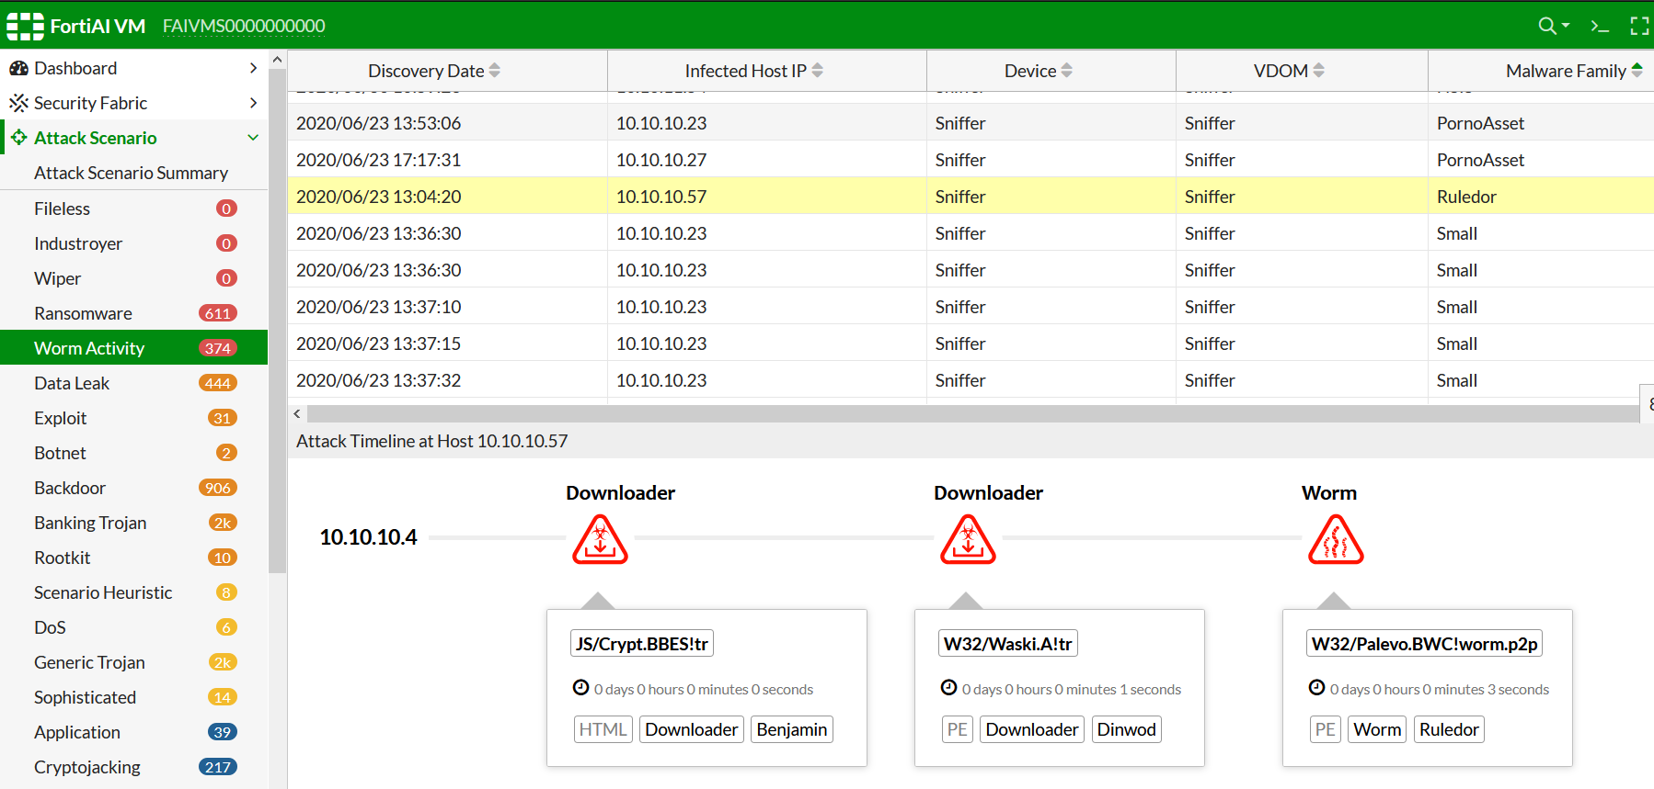
1
Virtual Security AnalystTM оснащённый Deep Neural Networks, который иденцифирует , классицифирует, и расследует сложные атаки и блокирует их
1
Иденцифирует
Останавливает угрозы в считанные секунды
Решает
SecOps встречают огромное кол-во угроз, в том числе False Positive (на что уходит очень много времени)
Распознает угрозы менее, чем за секунду
Notes:
FortiAI split-second layered decision inherent in the DNN model easily disrupts threats with sub-second detection and self-learning helps adapts to new threats instantaneously. This helps solve the SecOps challenge of facing increased volume, velocity and sophistication of threats.

Slide 12
Virtual Security AnalystTM оснащённый Deep Neural Networks, который иденцифирует , классицифирует, и расследует сложные атаки и блокирует их
2
2
Классифицирует
Распознает класс угрозы и их действия в системе
Решает
Угрозы, которые скрываются засчёт скрывания своей зловредной активности
Notes:
FortiAI uses Deep Neural Networks to scientifically analyze millions of malware characteristics to accurately determine the type of threat be it a ransomware, trojan, backdoor, etc. and this in turn reduces false positives. This helps uncover masquerading malware i.e. malware masked as legitimate objects or a different malware type, that not only serves to evade security controls but prolong mitigation efforts.

Slide 13
Virtual Security AnalystTM оснащённый Deep Neural Networks, который иденцифирует , классицифирует, и расследует сложные атаки и блокирует их
3
3
Расследует
Расследует угрозу в реальном времени, сохраняет её следы и делает это без задержек
Решает
Распознает горизонтальное и вертикальное распространение
Расследует в “Kill Chain” формате
Notes:
FortiAI speeds investigation by analyzing the threat in a kill chain format, highlighting tactics for the attack. It also analyzes threat movement and accurately identifies patient zero and subsequent victims in real-time. This helps eliminate manual investigation of a malware outbreak that overburdened Security Analysts are stuck with today.

Slide 14
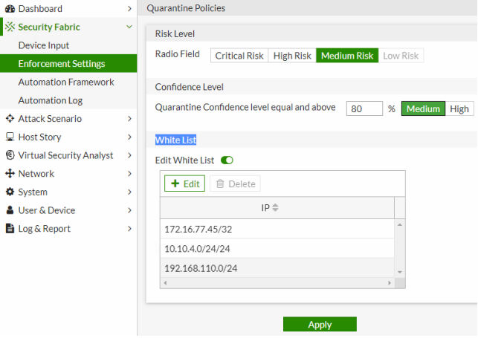
Virtual Security AnalystTM оснащённый Deep Neural Networks, который иденцифирует , классицифирует, и расследует сложные атаки и блокирует их
4
4
Automated Response
Зассчёт интеграции с FortiGate – блокирует угрозы в реальном времени.
Решает
Сценарии по устранению угрозы в реальном времени
FortiGate Quarantine основывается на FortiAI risk & confidence levels
Notes:
Lastly, FortiAI automates the threat response by quarantining the threats through the FortiGate integration. This reduces manual mitigation efforts during a real-time attack or a malware outbreak scenario.

Slide 15
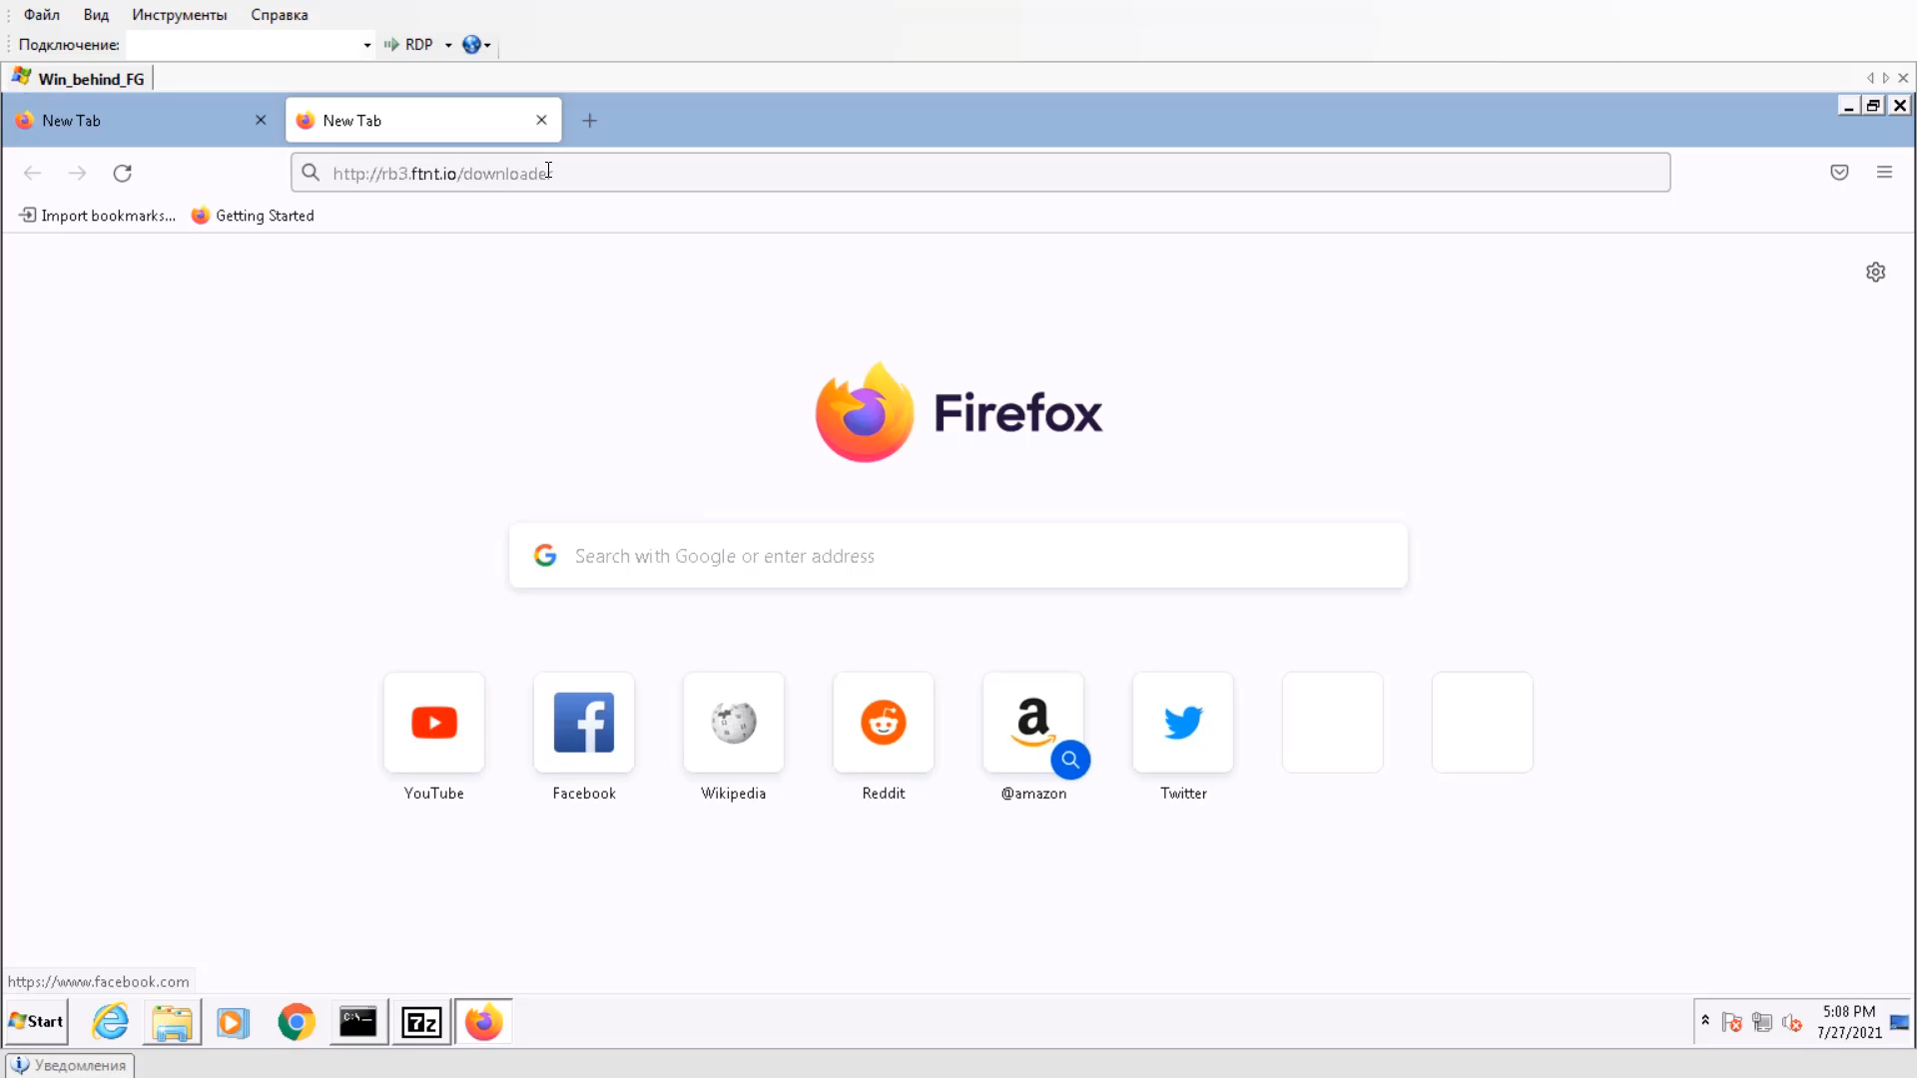

Slide 16







Интеграция с инфраструктурой
Deep Learning Virtual Security Analyst
ICAP/Fabric Connector
Syslog
Deep Pre-filter
Sub-second Protection
Расследование угроз
Углубленная защита
NGFW
SIEM | Analyzer
Sandbox
Блокирует угрозы
Ставит соединения в карантин
Работает в качестве pre-filter
Оптимизирует Dynamic Scan
Улучшает catch-rate
Уменьешает кол-во Fault-positives
Углубляет расследования инцидентов и угроз
WAF
Останавливает угрозы направленные на веб-приложения
SOAR
Автоматически запускает playbook ответ
Notes:
FortiAI Deep Learning capabilities enables organizations to benefit from a solution that is continuously self-learning and to apply instantaneous protection due to it’s sub-second verdict.
Organizations leverage FortiAI to build
Self-defending Networks
Works in conjunction with Next Gen FireWall such as FortiGate to stop the delivery of continuously evolving threats via network instantaneously
Self-defending Web Services
Works in conjunction with Web Application Firewall such as FortiWeb to uncover new attack patterns targeting web services and stop these threats instantaneously
AI-driven Orchestrated Response
Works in conjunction with Security Orchestration, Automation, and Response such as FortiSOAR to trigger appropriate playbook response across all security controls instantaneously
Through the seamless integration of FortiAI via ICAP, and Fabric connector, organizations enjoy the benefits of automating breach protection while solving InfoSec shortage.

Slide 17
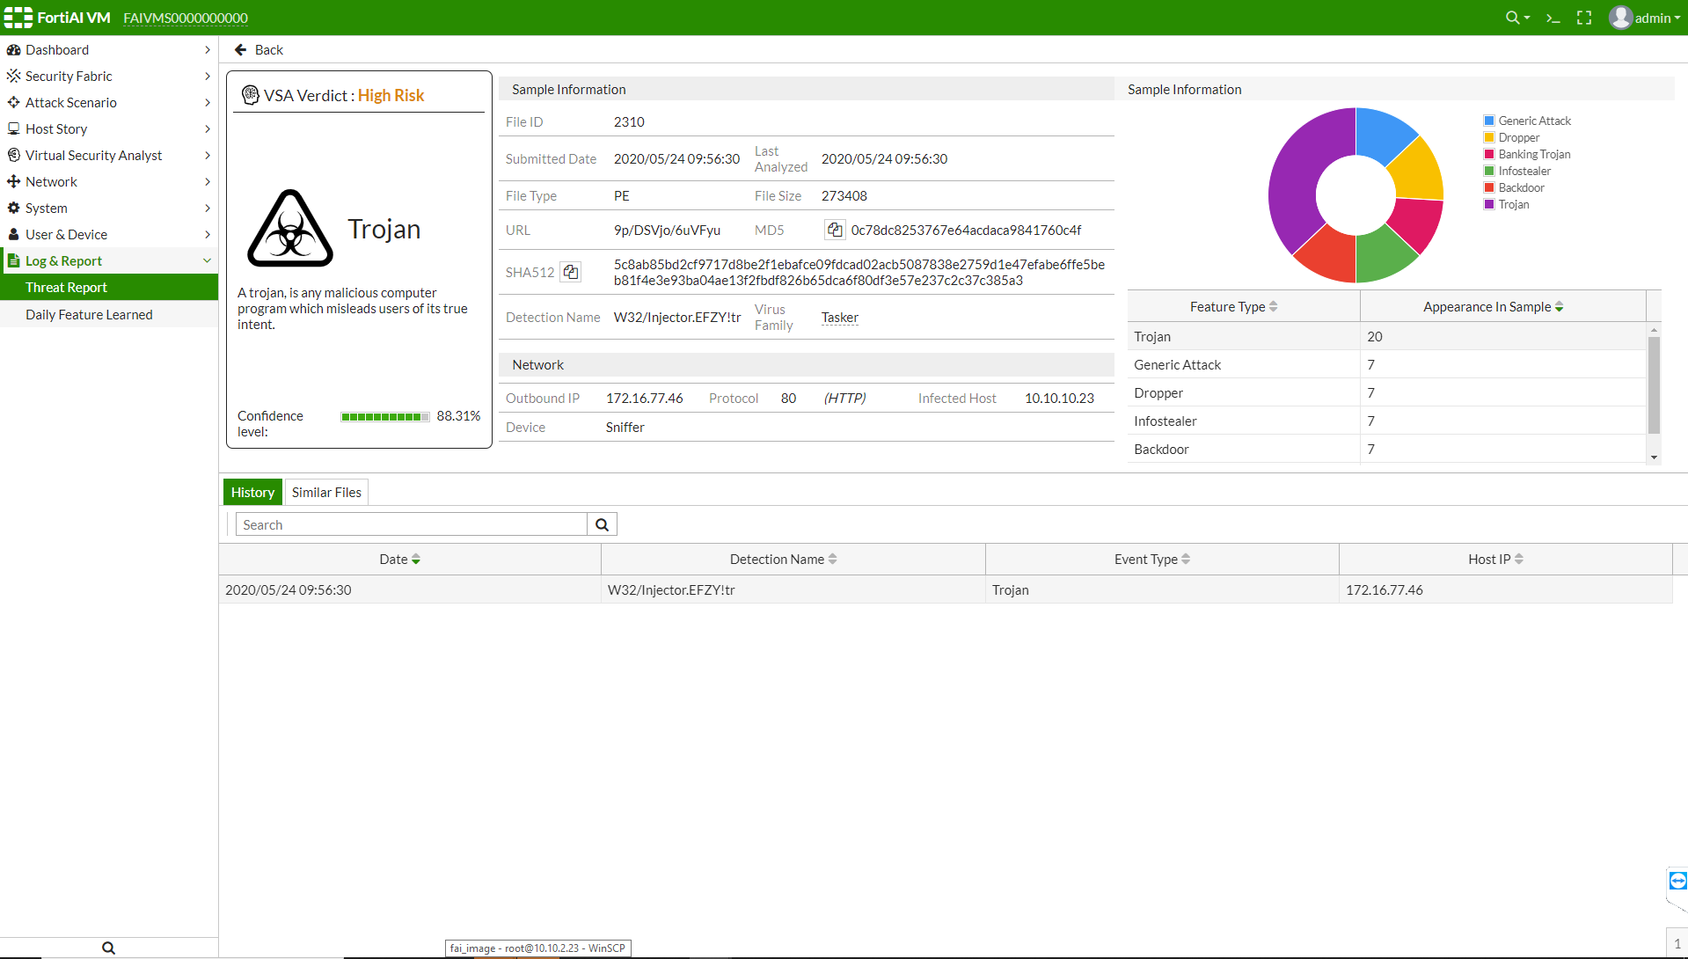
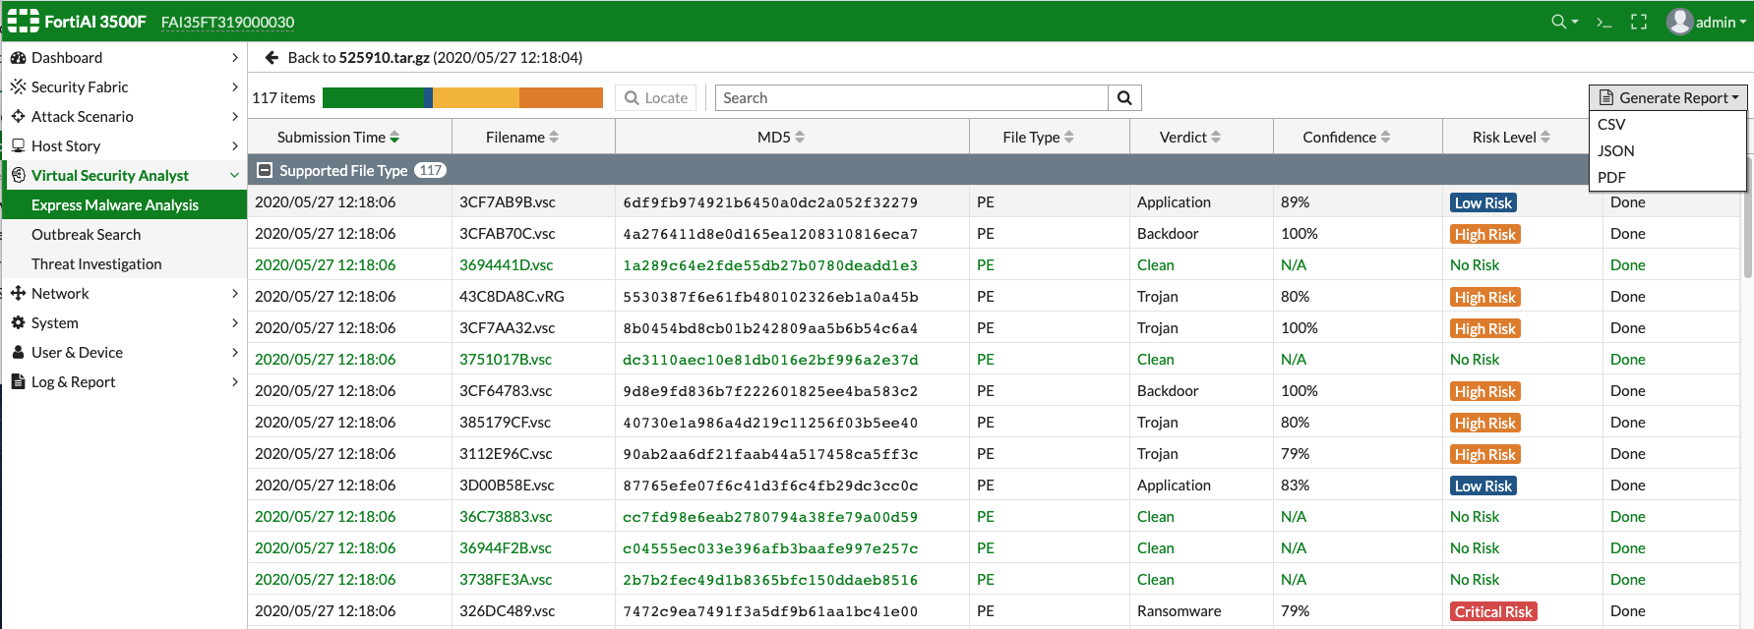
Загрузка файлов вручную - Express Malware Анализ
Manual & API Upload
REST API upload & Manual GUI Upload
Поддержка Compress File (tar, gz, tgz, zip, bz2, rar)
Password Support (e.g. infected)
Вердикт за секунду
Notes:
Manual upload / REST API upload (API in admin guide or FNDN)

Slide 18
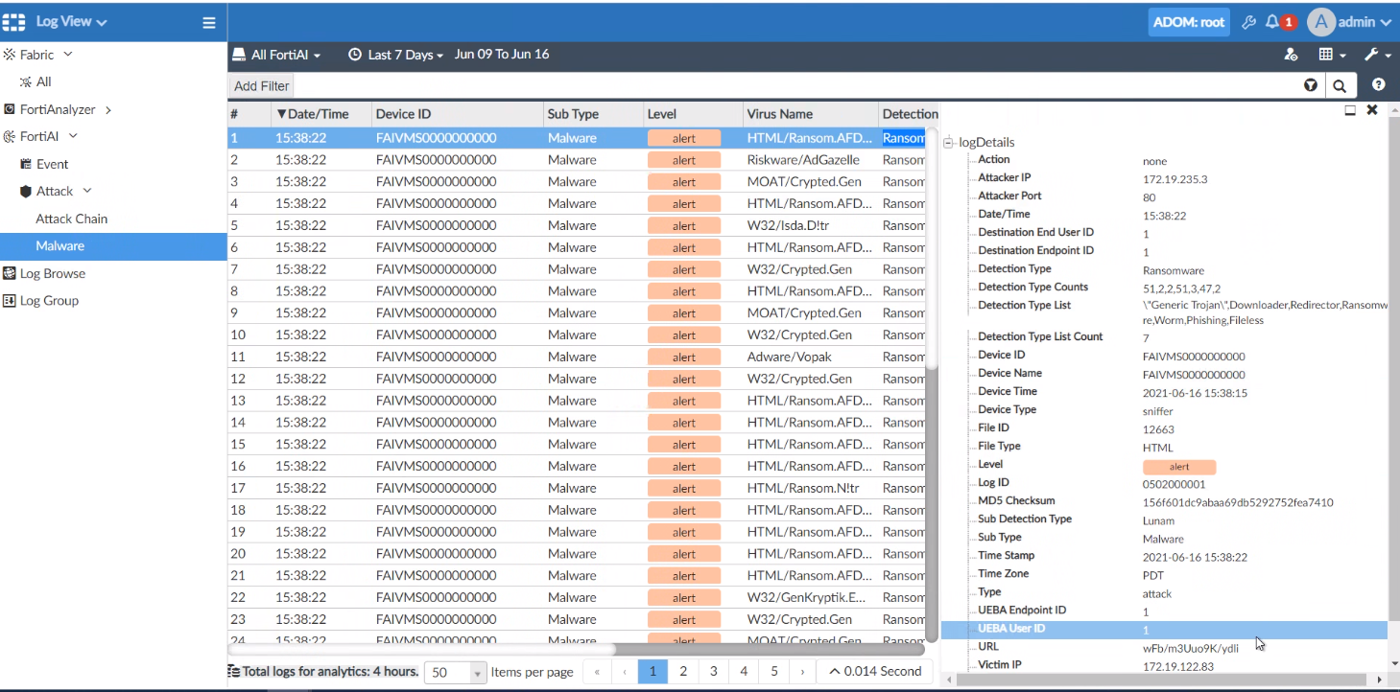
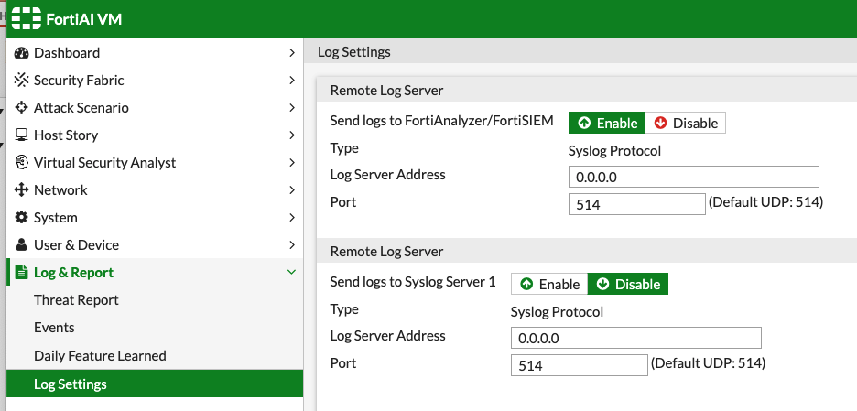
FortiAI - Интеграция с FortiAnalyzer
Поддержка отображения логов в FAZ 7.0.1 (Fabric ADOM)
Логи событий (performance, file summary statistics)
Логи атак (including kill chain logs)

Slide 19
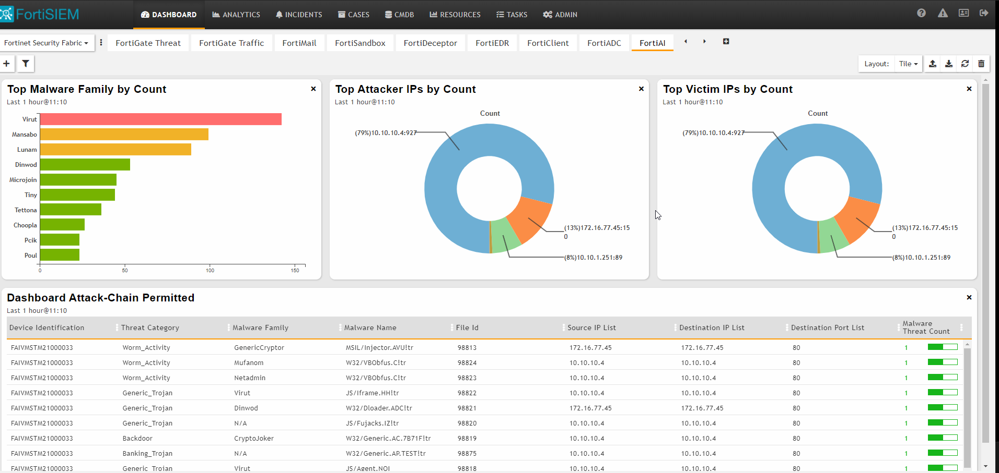
FortiAI - Интеграция с FortiSIEM
Поддержка FortiSIEM v6.3
Парсинг логов
FortiAI Dashboard
Prefilter правило – attack killchain – block
Отображение victim IP/Malware family

Slide 20



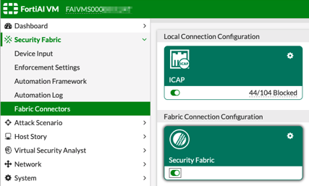
Интеграция FortiWeb
FortiWeb ICAP Support
FortiWeb ICAP client offloads to FortIAI ICAP Server
FortiWeb v6.3.11+
FortiAI v1.5.0+
Figure – FortiAI ICAP Connector
FortiWeb
FortiAI
Blocking of threats
ICAP offload
Web Servers
Configuration FWB: https://docs.fortinet.com/document/fortiweb/6.3.9/cli-reference/300895/system-icapserver

Slide 21
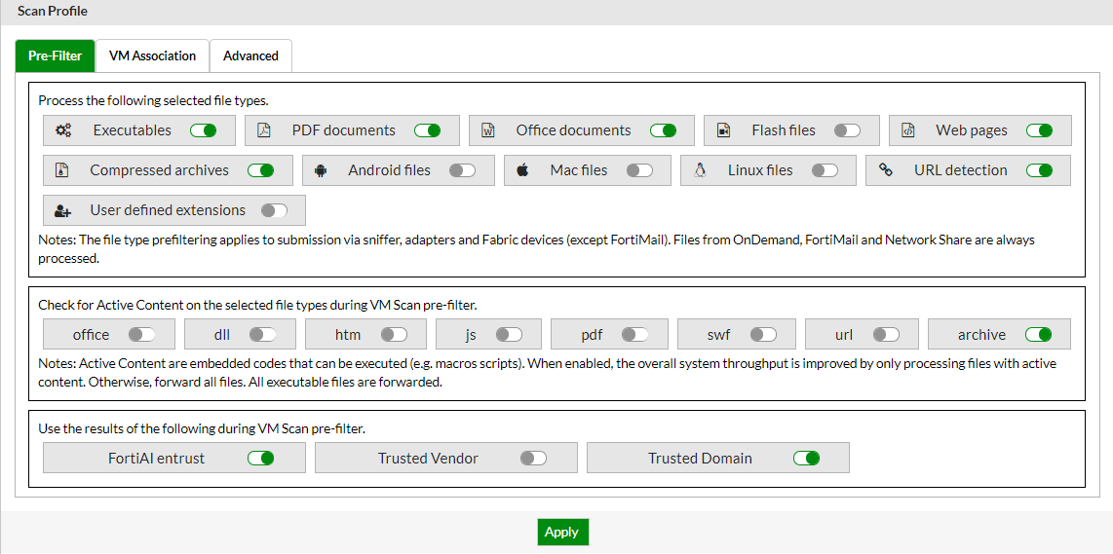
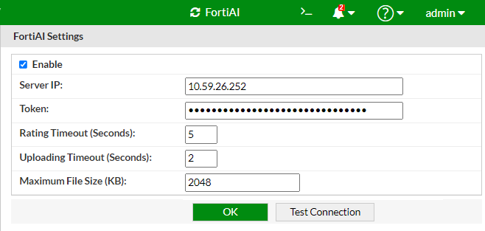
Интеграция FortiSandbox (FSA v4.0.1)
”

Slide 22


Интеграция FortiSandbox
Задача 1: Уменьшать нагрузку на Sandbox dynamic scan (VM)
Способ исполнения: FortiAI возвращает вердикт за секунды, что позволяет использовать FortiAI в качестве Pre-filter
Задача 2: Расширить Detect rate и площадь защиты
Способ исполнения: Использовать две технологии взаимодополняющее друг друга
Задача 3: Удобная и гибкая интеграция
Способ исполнения: Различные методы интеграции
FGT
FAI (inline blocking/ OFTP)
FWB
FAI (ICAP server)
FGT
FWB
FAI (Уменьшает FSA нагрузку, увеличивает площадь защиты)
FSA
FAI (Уменьшает FSA нагрузку, увеличивает площадь защиты)
FSA

Slide 23

FortiAI – Архитектура Security Fabric
FortiGuard Neural Network Updates
Virtual Security AnalystTM
HQ FortiGate
(Inline Blocking)
Infected Source
Worms / Lateral Movement
Integrated / Encrypted submissions
Malicious File
FortiAI
(ICAP Server)
Remote FortiGate(s)
Protected endpoints
File submission
Verdict
FortiSIEM & FortiAnalyzer
Logging and Reporting
FortiSOAR File submission
FortiSandbox Integration
Sniffer / SPAN SMB v2, Web and Email Traffic
Fortiweb
(ICAP client)
^{DMZ servers}
^{Web servers}

